Slide 1
A
Transition times
Fixed parameters
d_{IR}
1-r
d_{EI}
S
E
I
R
μ(t)β
r
1-α
d_{EI}
d_{IR}
α
d_{IH}
1-κ
H
d_{HR}
1-δ
d_{HQ}
S = Susceptible
E = Exposed
A = Infected/Undetected
I = Infected/Detected
H = Hospitalized
Q = ICU
V = Ventilated
D = Death
R = Recovered
κ
Q
d_{QD}
V
d_{QV}
D
δ
Notes:
of our model over existing models estimating hospital resource demand is that it accounts for combinations of risk factors (age, unhealthy behaviors, existing comorbidities, and combinations of comorbidities), including area-level differences in prevalence of these risk factors, in determining COVID intensity. Accounting for differential risk for specific populations is important both for making projections about the scale of the epidemic, and for prioritizing at-risk populations for protection.

Slide 2
Time-dependent Factor reduction in R0
Proportion of illnesses that are detected
A
Estimated parameters
1-r
S
E
I
R
μ(t)β
r
1-α
Infectivity rate
β ~ R0
α
1-κ
Pr(Hospital|Illness)
H
1-δ
S = Susceptible
E = Exposed
A = Infected/Undetected
I = Infected/Detected
H = Hospitalized
Q = ICU
V = Ventilated
D = Death
R = Recovered
κ
Q
Pr(ICU|Hospital)
V
D
δ
Pr(Death|ICU)
Notes:
of our model over existing models estimating hospital resource demand is that it accounts for combinations of risk factors (age, unhealthy behaviors, existing comorbidities, and combinations of comorbidities), including area-level differences in prevalence of these risk factors, in determining COVID intensity. Accounting for differential risk for specific populations is important both for making projections about the scale of the epidemic, and for prioritizing at-risk populations for protection.

Slide 3
Transmission reduction factor
Proportion of illnesses that are detected
A
Estimated parameters
1-r
S
E
I
R
μ(t)β
r
1-α
Infectivity rate
β ~ R0
α
1-κ
Pr(Hospital|Illness)
H
1-δ
S = Susceptible
E = Exposed
A = Infected/Undetected
I = Infected/Detected
H = Hospitalized
Q = ICU
V = Ventilated
D = Death
R = Recovered
κ
Q
Pr(ICU|Hospital)
V
D
δ
Pr(Death|ICU)
Notes:
of our model over existing models estimating hospital resource demand is that it accounts for combinations of risk factors (age, unhealthy behaviors, existing comorbidities, and combinations of comorbidities), including area-level differences in prevalence of these risk factors, in determining COVID intensity. Accounting for differential risk for specific populations is important both for making projections about the scale of the epidemic, and for prioritizing at-risk populations for protection.

Slide 4
Transmission reduction factor
Proportion of illnesses that are detected
A
Estimated parameters
1-r
S
E
I
R
μ(t)β
r
1-α
Infectivity rate
β ~ R0
α
1-κ
H
1-δ
S = Susceptible
E = Exposed
A = Infected/Undetected
I = Infected/Detected
H = Hospitalized
Q = ICU
V = Ventilated
D = Death
R = Recovered
κ
Q
V
D
δ
Notes:
of our model over existing models estimating hospital resource demand is that it accounts for combinations of risk factors (age, unhealthy behaviors, existing comorbidities, and combinations of comorbidities), including area-level differences in prevalence of these risk factors, in determining COVID intensity. Accounting for differential risk for specific populations is important both for making projections about the scale of the epidemic, and for prioritizing at-risk populations for protection.

Slide 5
Available data:
Marginal probability of COVID outcome given single risk factors
Statistical model:
Joint probability of COVID outcome given combinations of risk factors
Pr(Hospital|Illness)
Pr(ICU|Hospital)
Pr(Death|ICU)
Prior distributions
Epidemic model
Post-hoc stratified analysis of risk factors
Notes:
of our model over existing models estimating hospital resource demand is that it accounts for combinations of risk factors (age, unhealthy behaviors, existing comorbidities, and combinations of comorbidities), including area-level differences in prevalence of these risk factors, in determining COVID intensity.
Borrow correlation structure between these parameters to get this
Bring in local LA data on risk factors to make these estimates
Benefit: Accounting for differential risk for specific populations is important both for making projections about the scale of the epidemic, and for prioritizing at-risk populations for protection.
Also lets us do analyses that control for specific risk factors – controlling for higher rates of disparities in these groups

Slide 12
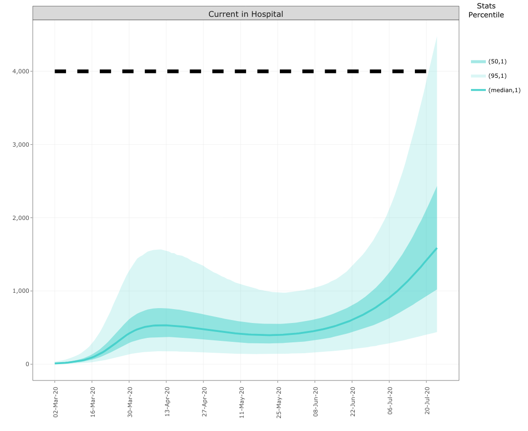
Modifications
19-Mar-20
8-May-20
12-Jun-20
28-Jun-20
Phase 1
Phase 2
Phase 3

Slide 13
Modifications
Stage 1
Stage 2
Stage 3
19-Mar
8-May
12-Jun
28-Jun
Notes:
Stage I (Initial shutdown): March 19 - May 7
All non-essential businesses closed, schools closed.
* The outbreak begins in Los Angeles with clear exponential spread; full County-wide policy and effort to dramatically limit healthcare overload and deaths by limiting spread. Successful in decreasing hospitalizations, critical illnesses, and deaths (with a delay).
Stage II: May 8 - June 11
Low-risk businesses, public spaces for exercise allowed to open (May 8); followed by retail stores for curbside pickup (May 13); houses of worship, political protests, offices that cannot support remote work (May 26); salons and restaurants for on-site dining (May 29)
* Hospitalizations, critical illnesses, and deaths start increasing following the increasing reopening (and subsequent increase in contact rate – see mobility data) in Stage 2
Stage III: June 12 - current
Process of further reopening: First steps open medium-risk (REF) businesses including gyms, museums, hotels (June 12), followed by high-risk (REF) establishments including salons, bars, restaurants (June 19).
* Hospitalizations and severe illnesses start increasing; modifications follow to close highest risk establishments including Bars and wineries closed (June 28); followed by indoor dining at restaurants (July 1); and gyms, indoor malls, houses of worship, non-critical offices, and salons (July 13). Illnesses continue to spread as R(t) continues to rise, or stabilize (as seen in the mobility data); hospitalizations and critical illnesses continue to rise. Notably, an increase in deaths has not begun to follow, even after 6 weeks of sustained increase in hospitalizations.
- Need to discuss R(t) specifically: and how this embodies mobility data.
- Start by describing all 3 at a high level (introducing what they are). Then describe in context of key dates. Then describe what the total prevalence rate means – may want Dave’s suggestions on this

Slide 14
Modifications
Stage 1
Stage 2
Stage 3
19-Mar
8-May
12-Jun
28-Jun
Notes:
Stage I (Initial shutdown): March 19 - May 7
All non-essential businesses closed, schools closed.
* The outbreak begins in Los Angeles with clear exponential spread; full County-wide policy and effort to dramatically limit healthcare overload and deaths by limiting spread. Successful in decreasing hospitalizations, critical illnesses, and deaths (with a delay).
Stage II: May 8 - June 11
Low-risk businesses, public spaces for exercise allowed to open (May 8); followed by retail stores for curbside pickup (May 13); houses of worship, political protests, offices that cannot support remote work (May 26); salons and restaurants for on-site dining (May 29)
* Hospitalizations, critical illnesses, and deaths start increasing following the increasing reopening (and subsequent increase in contact rate – see mobility data) in Stage 2
Stage III: June 12 - current
Process of further reopening: First steps open medium-risk (REF) businesses including gyms, museums, hotels (June 12), followed by high-risk (REF) establishments including salons, bars, restaurants (June 19).
* Hospitalizations and severe illnesses start increasing; modifications follow to close highest risk establishments including Bars and wineries closed (June 28); followed by indoor dining at restaurants (July 1); and gyms, indoor malls, houses of worship, non-critical offices, and salons (July 13). Illnesses continue to spread as R(t) continues to rise, or stabilize (as seen in the mobility data); hospitalizations and critical illnesses continue to rise. Notably, an increase in deaths has not begun to follow, even after 6 weeks of sustained increase in hospitalizations.
- Need to discuss R(t) specifically: and how this embodies mobility data.
- Start by describing all 3 at a high level (introducing what they are). Then describe in context of key dates. Then describe what the total prevalence rate means – may want Dave’s suggestions on this

Slide 15
Modifications
Stage 1
Stage 2
Stage 3
19-Mar
8-May
12-Jun
28-Jun
Notes:
Stage I (Initial shutdown): March 19 - May 7
All non-essential businesses closed, schools closed.
* The outbreak begins in Los Angeles with clear exponential spread; full County-wide policy and effort to dramatically limit healthcare overload and deaths by limiting spread. Successful in decreasing hospitalizations, critical illnesses, and deaths (with a delay).
Stage II: May 8 - June 11
Low-risk businesses, public spaces for exercise allowed to open (May 8); followed by retail stores for curbside pickup (May 13); houses of worship, political protests, offices that cannot support remote work (May 26); salons and restaurants for on-site dining (May 29)
* Hospitalizations, critical illnesses, and deaths start increasing following the increasing reopening (and subsequent increase in contact rate – see mobility data) in Stage 2
Stage III: June 12 - current
Process of further reopening: First steps open medium-risk (REF) businesses including gyms, museums, hotels (June 12), followed by high-risk (REF) establishments including salons, bars, restaurants (June 19).
* Hospitalizations and severe illnesses start increasing; modifications follow to close highest risk establishments including Bars and wineries closed (June 28); followed by indoor dining at restaurants (July 1); and gyms, indoor malls, houses of worship, non-critical offices, and salons (July 13). Illnesses continue to spread as R(t) continues to rise, or stabilize (as seen in the mobility data); hospitalizations and critical illnesses continue to rise. Notably, an increase in deaths has not begun to follow, even after 6 weeks of sustained increase in hospitalizations.
- Need to discuss R(t) specifically: and how this embodies mobility data.
- Start by describing all 3 at a high level (introducing what they are). Then describe in context of key dates. Then describe what the total prevalence rate means – may want Dave’s suggestions on this

Slide 16
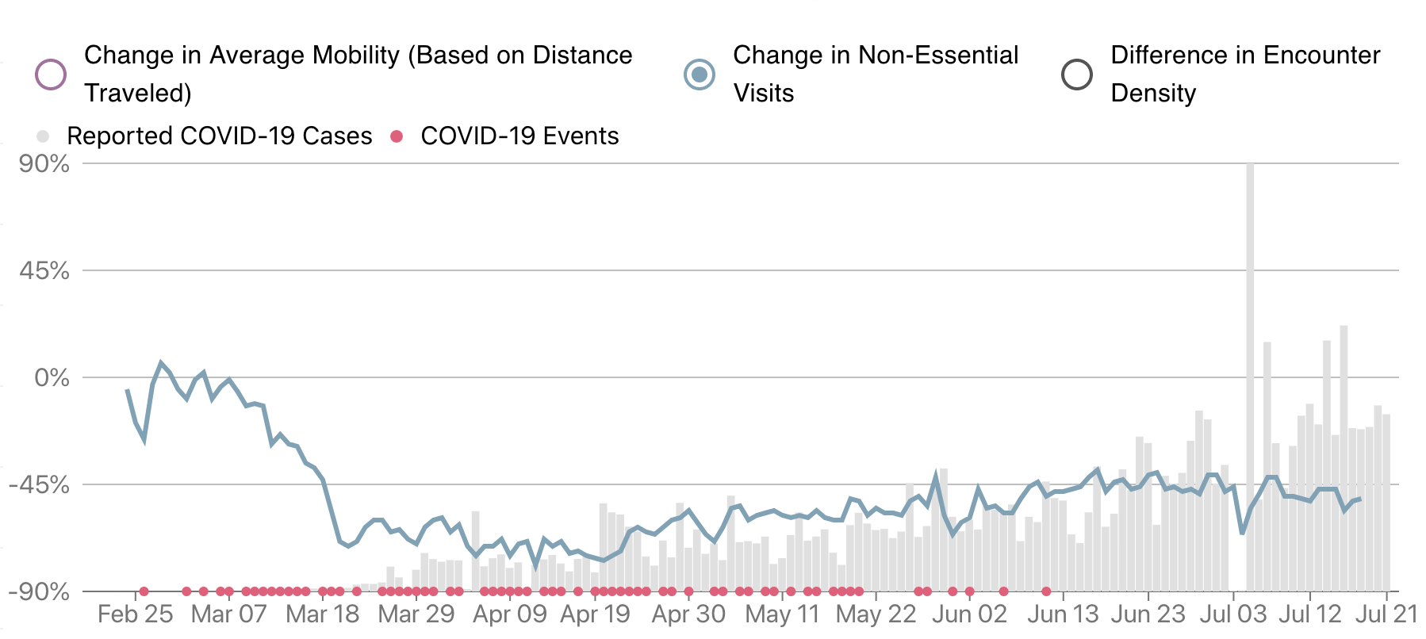
Modifications
Stage 1
Stage 2
Stage 3
19-Mar
8-May
12-Jun
28-Jun
Notes:
Stage I (Initial shutdown): March 19 - May 7
All non-essential businesses closed, schools closed.
* The outbreak begins in Los Angeles with clear exponential spread; full County-wide policy and effort to dramatically limit healthcare overload and deaths by limiting spread. Successful in decreasing hospitalizations, critical illnesses, and deaths (with a delay).
Stage II: May 8 - June 11
Low-risk businesses, public spaces for exercise allowed to open (May 8); followed by retail stores for curbside pickup (May 13); houses of worship, political protests, offices that cannot support remote work (May 26); salons and restaurants for on-site dining (May 29)
* Hospitalizations, critical illnesses, and deaths start increasing following the increasing reopening (and subsequent increase in contact rate – see mobility data) in Stage 2
Stage III: June 12 - current
Process of further reopening: First steps open medium-risk (REF) businesses including gyms, museums, hotels (June 12), followed by high-risk (REF) establishments including salons, bars, restaurants (June 19).
* Hospitalizations and severe illnesses start increasing; modifications follow to close highest risk establishments including Bars and wineries closed (June 28); followed by indoor dining at restaurants (July 1); and gyms, indoor malls, houses of worship, non-critical offices, and salons (July 13). Illnesses continue to spread as R(t) continues to rise, or stabilize (as seen in the mobility data); hospitalizations and critical illnesses continue to rise. Notably, an increase in deaths has not begun to follow, even after 6 weeks of sustained increase in hospitalizations.
- Need to discuss R(t) specifically: and how this embodies mobility data.
- Start by describing all 3 at a high level (introducing what they are). Then describe in context of key dates. Then describe what the total prevalence rate means – may want Dave’s suggestions on this

Slide 18
Modifications
Stage 1
Stage 2
Stage 3
19-Mar
8-May
12-Jun
28-Jun
Capacity
Hospital
ICU
Notes:
Stage I (Initial shutdown): March 19 - May 7
All non-essential businesses closed, schools closed.
* The outbreak begins in Los Angeles with clear exponential spread; full County-wide policy and effort to dramatically limit healthcare overload and deaths by limiting spread. Successful in decreasing hospitalizations, critical illnesses, and deaths (with a delay).
Stage II: May 8 - June 11
Low-risk businesses, public spaces for exercise allowed to open (May 8); followed by retail stores for curbside pickup (May 13); houses of worship, political protests, offices that cannot support remote work (May 26); salons and restaurants for on-site dining (May 29)
* Hospitalizations, critical illnesses, and deaths start increasing following the increasing reopening (and subsequent increase in contact rate – see mobility data) in Stage 2
Stage III: June 12 - current
Process of further reopening: First steps open medium-risk (REF) businesses including gyms, museums, hotels (June 12), followed by high-risk (REF) establishments including salons, bars, restaurants (June 19).
* Hospitalizations and severe illnesses start increasing; modifications follow to close highest risk establishments including Bars and wineries closed (June 28); followed by indoor dining at restaurants (July 1); and gyms, indoor malls, houses of worship, non-critical offices, and salons (July 13). Illnesses continue to spread as R(t) continues to rise, or stabilize (as seen in the mobility data); hospitalizations and critical illnesses continue to rise. Notably, an increase in deaths has not begun to follow, even after 6 weeks of sustained increase in hospitalizations.
- Need to discuss R(t) specifically: and how this embodies mobility data.
- Start by describing all 3 at a high level (introducing what they are). Then describe in context of key dates. Then describe what the total prevalence rate means – may want Dave’s suggestions on this

Slide 19
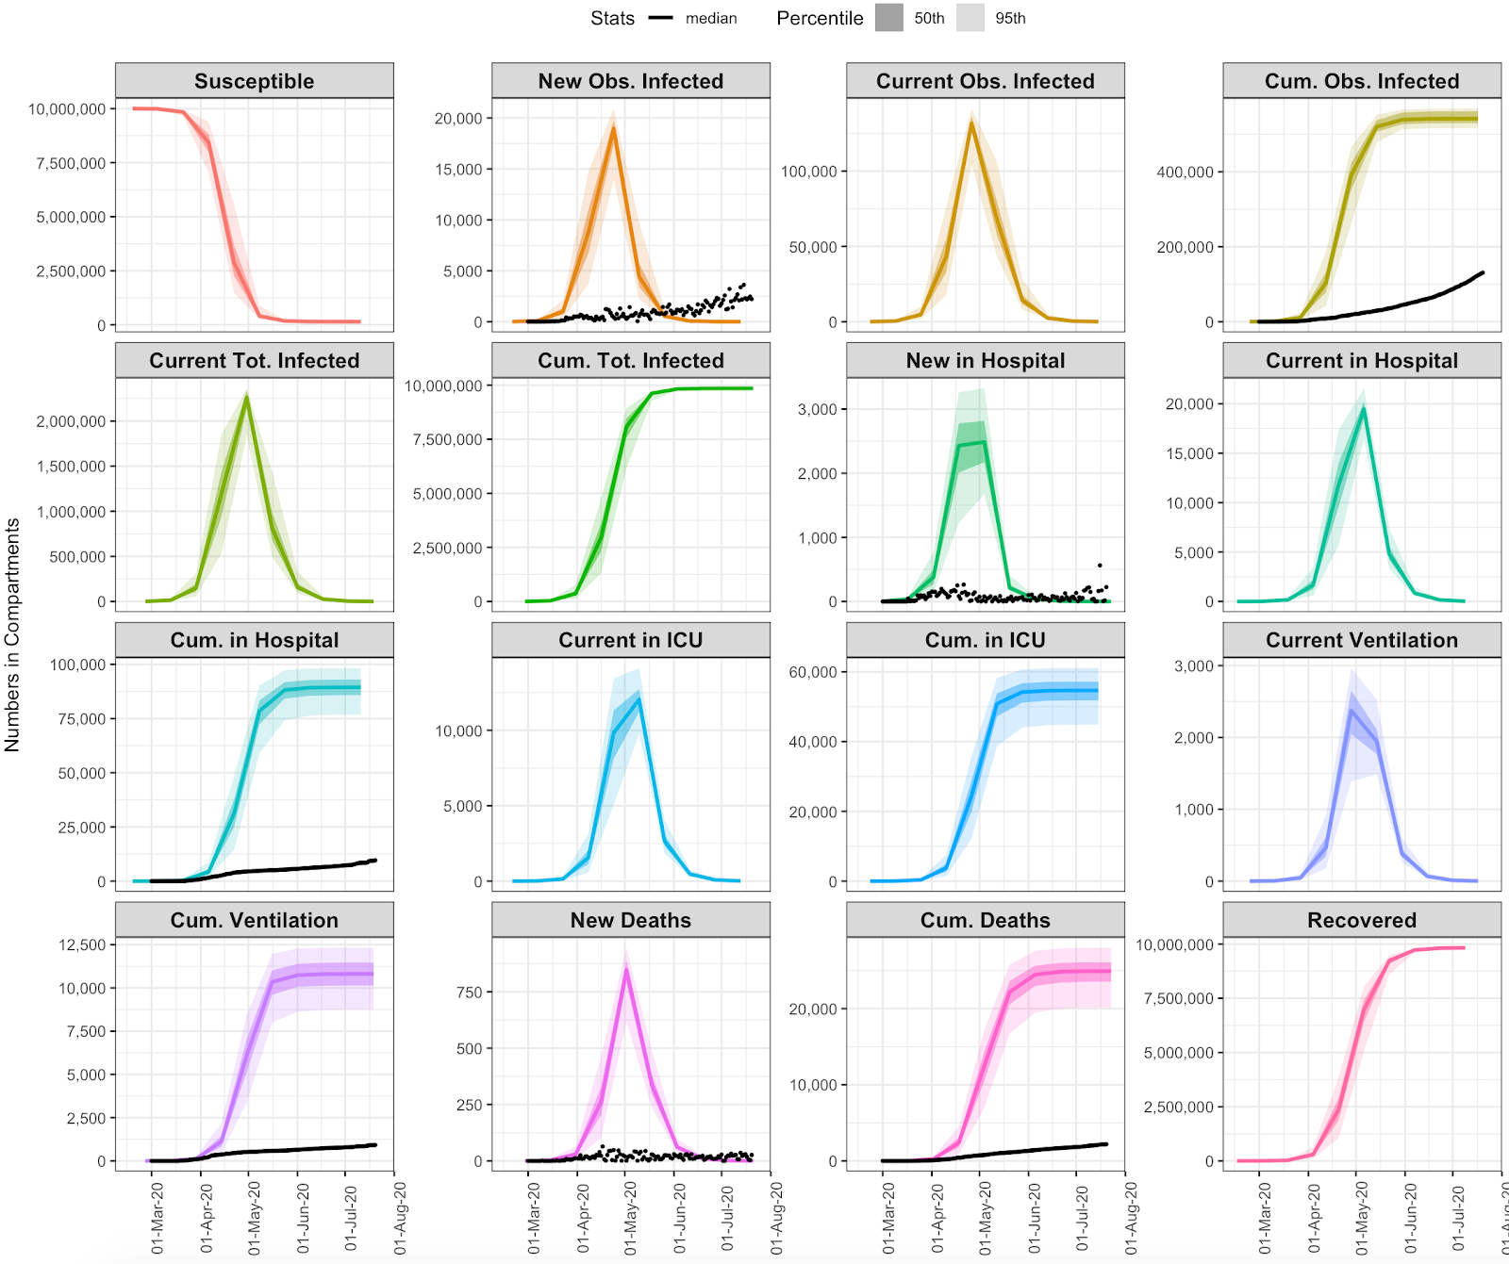
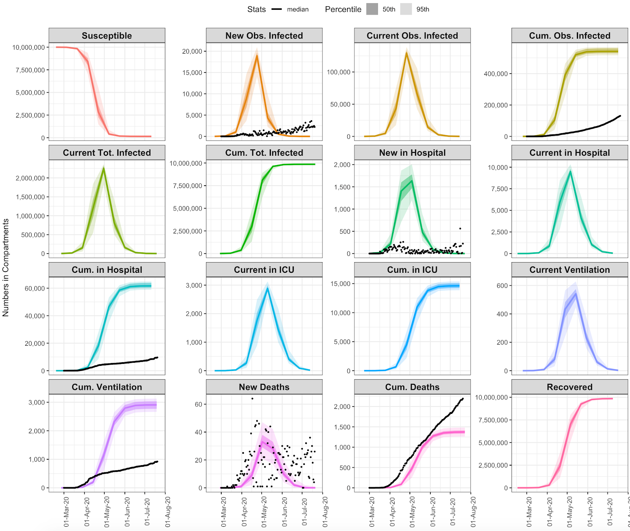
## SCENARIO 0: R0 DO NOTHING
(Trump Scenario)
## SCENARIO 1: R0 DO NOTHING + SHIELD SPECIFIC POPULATIONS

Slide 20
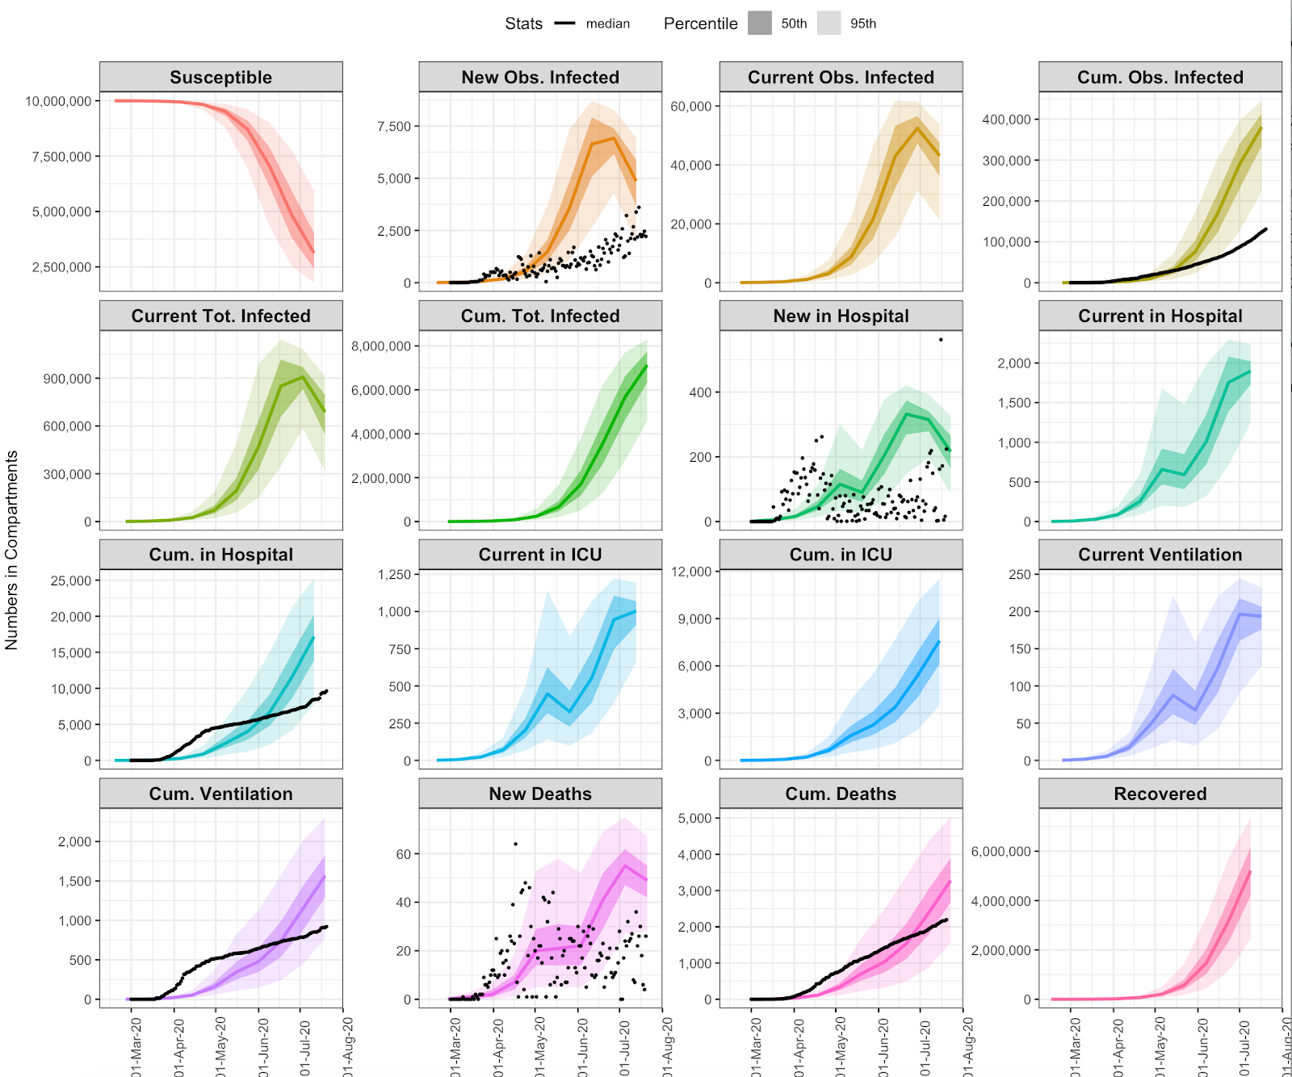
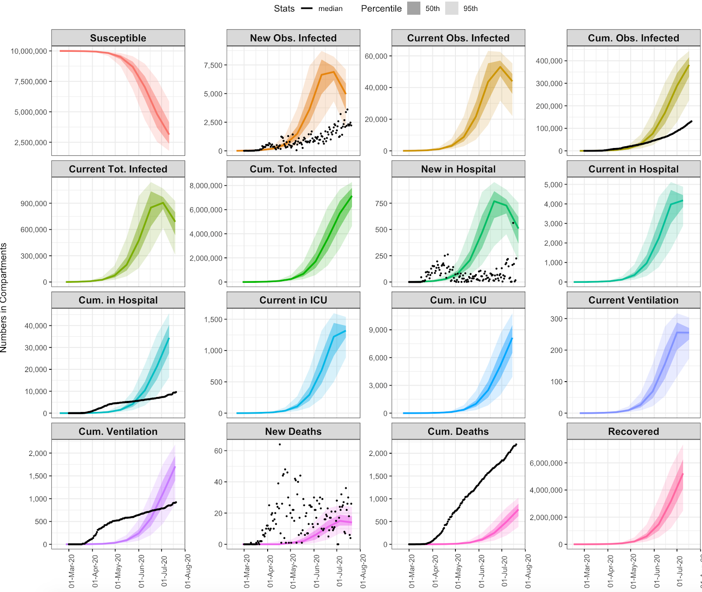
## SCENARIO 2: STAGE 3 SELF-ADAPTIVE Rt (go almost immediately into Stage 3)
## SCENARIO 3: STAGE 3 SELF-ADAPTIVE Rt + SHIELD SPECIFIC POPULATIONS (this is what I would call Sweden Scenario)

Slide 21
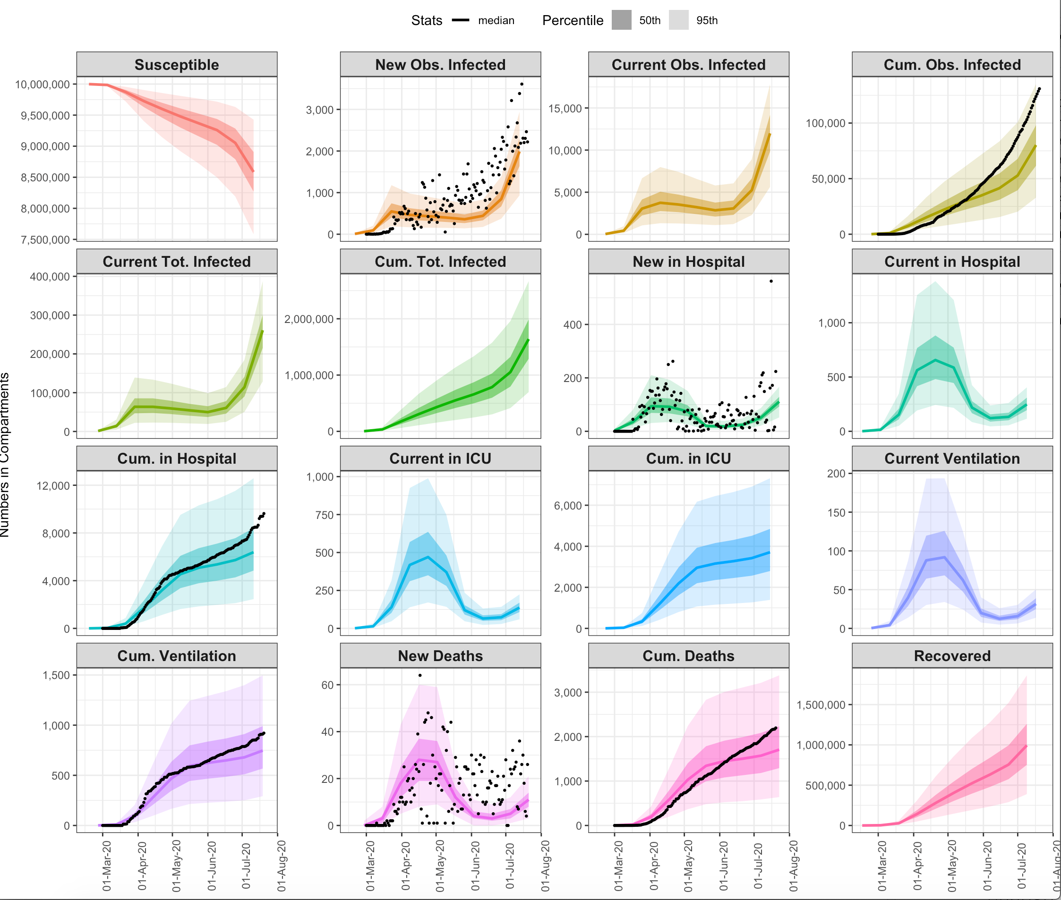
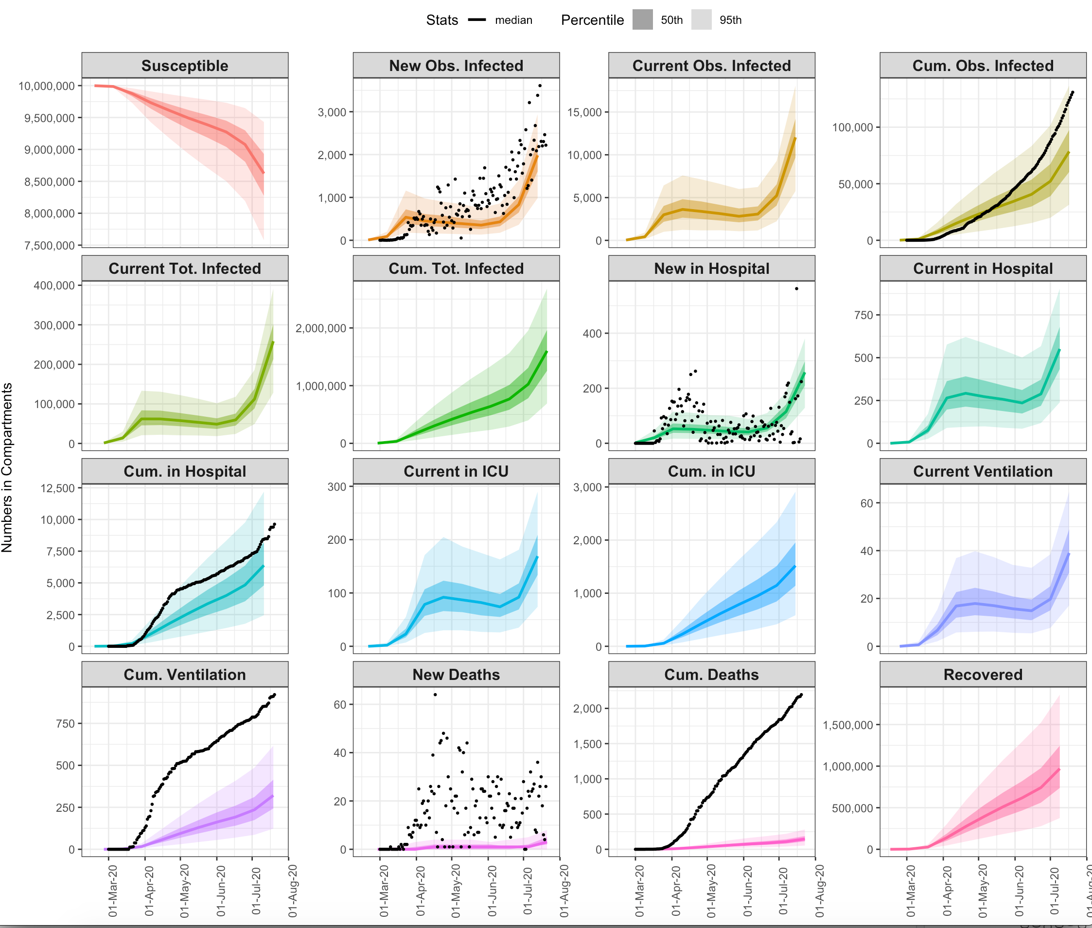
## SCENARIO 4: CONTINUE TOTAL LOCKDOWN 1 MONTH LONGER
## SCENARIO 5: CONTINUE TOTAL LOCKDOWN 1 MONTH LONGER + SHIELD SPECIFIC POPULATIONS

Slide 22
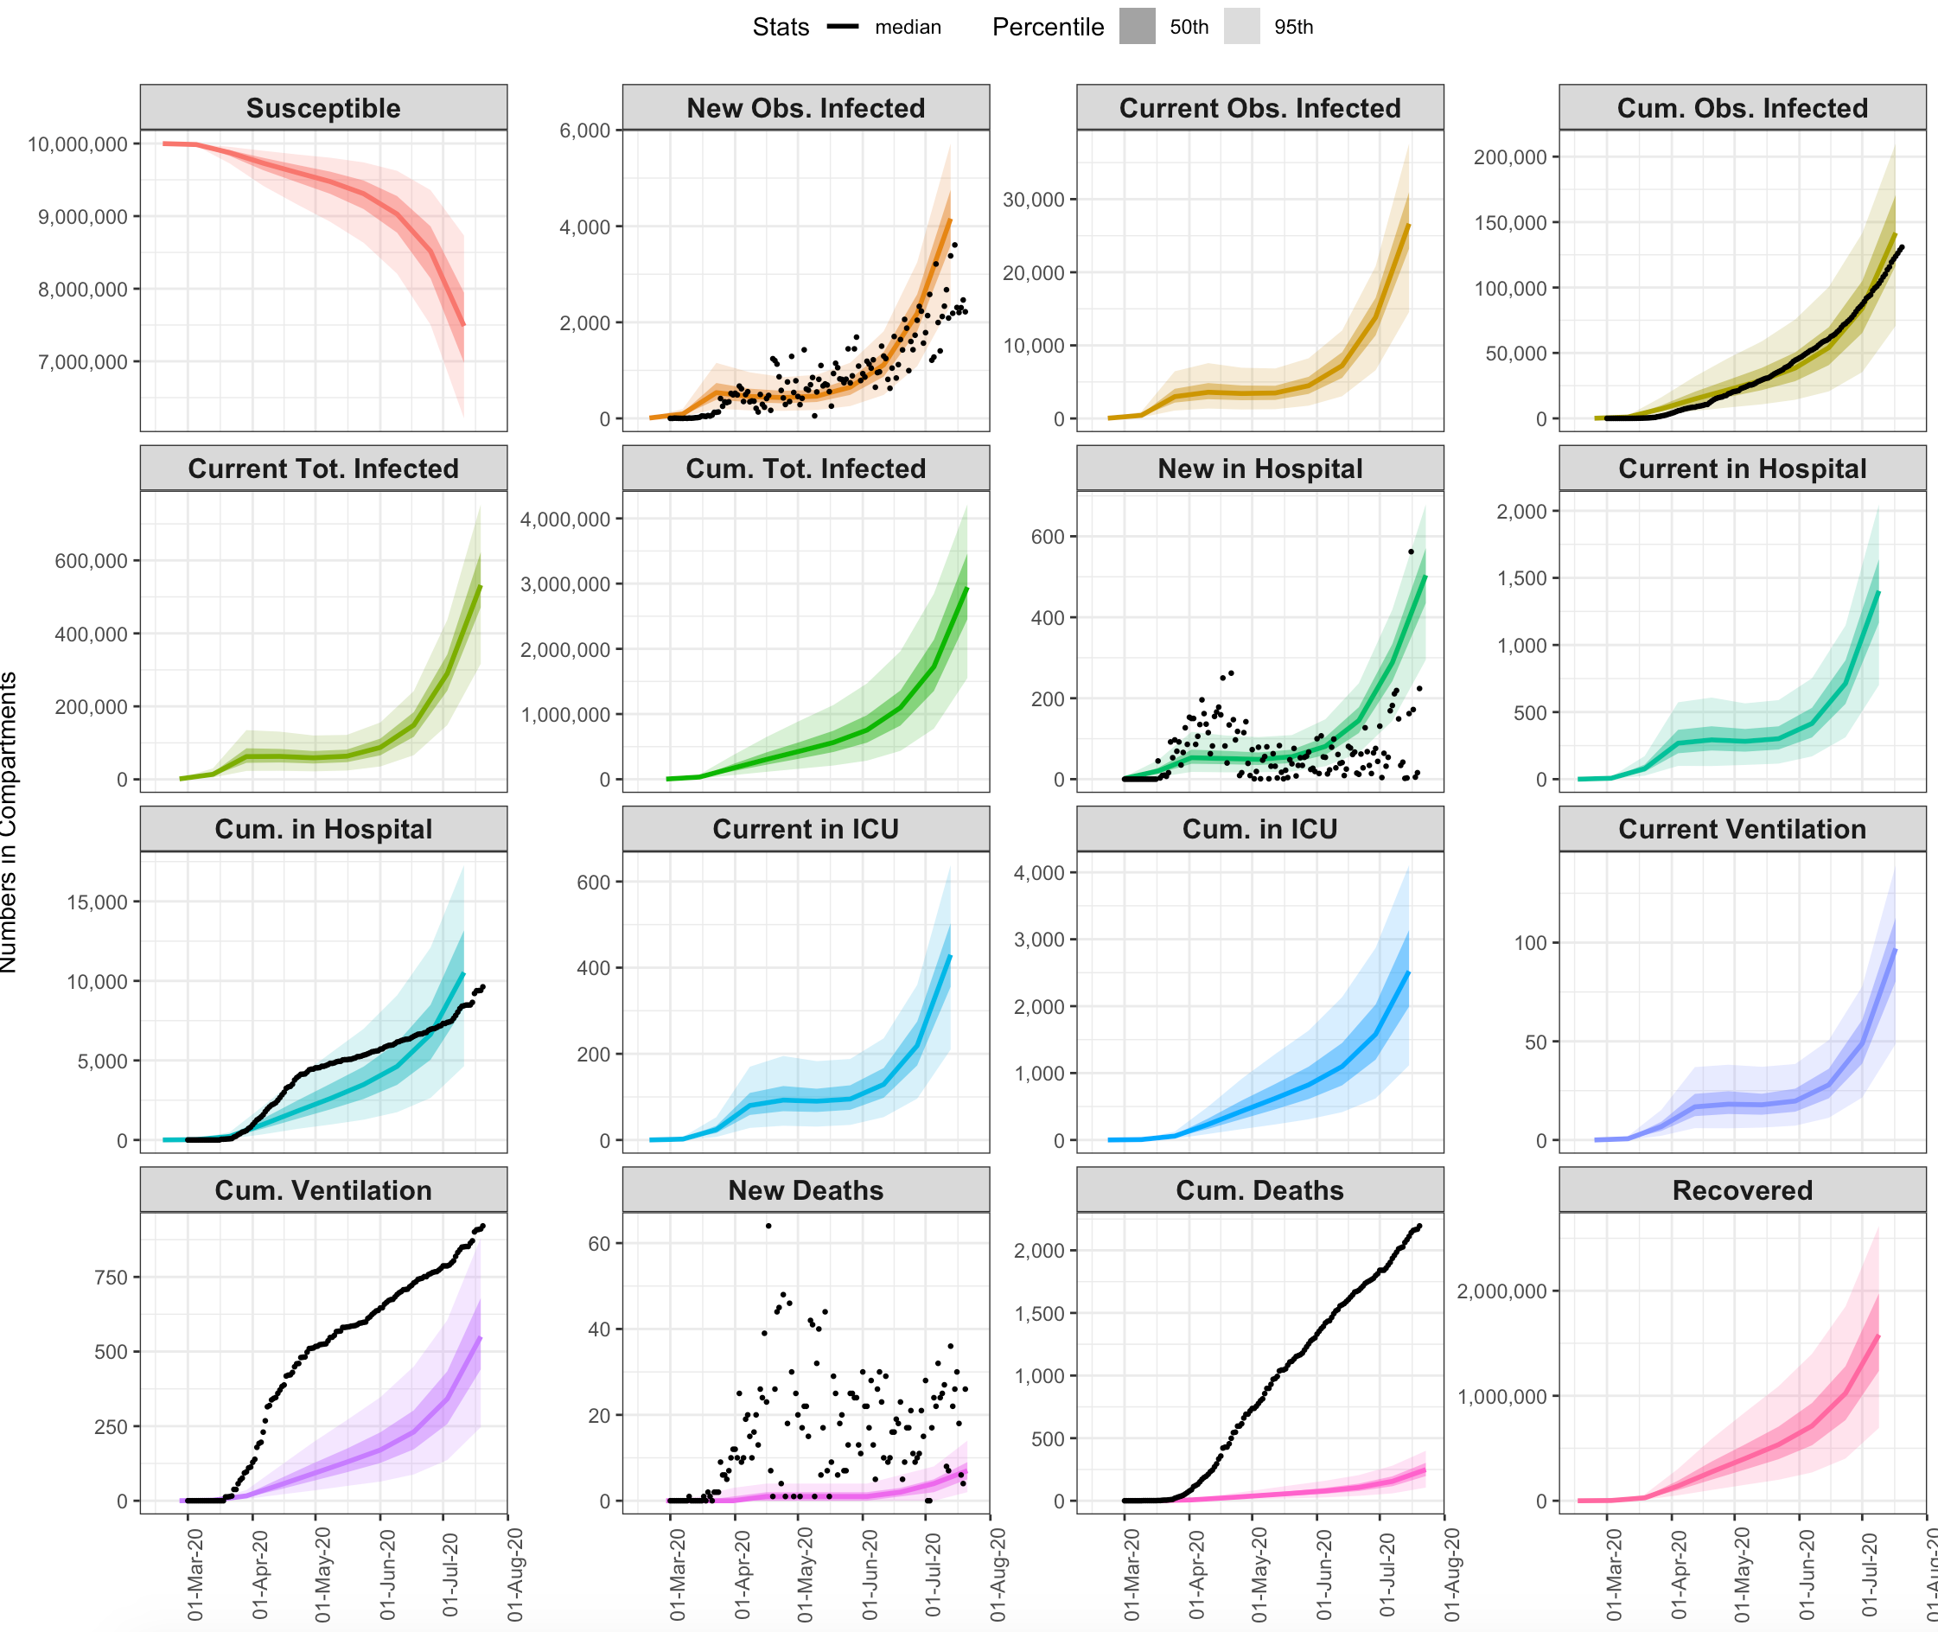
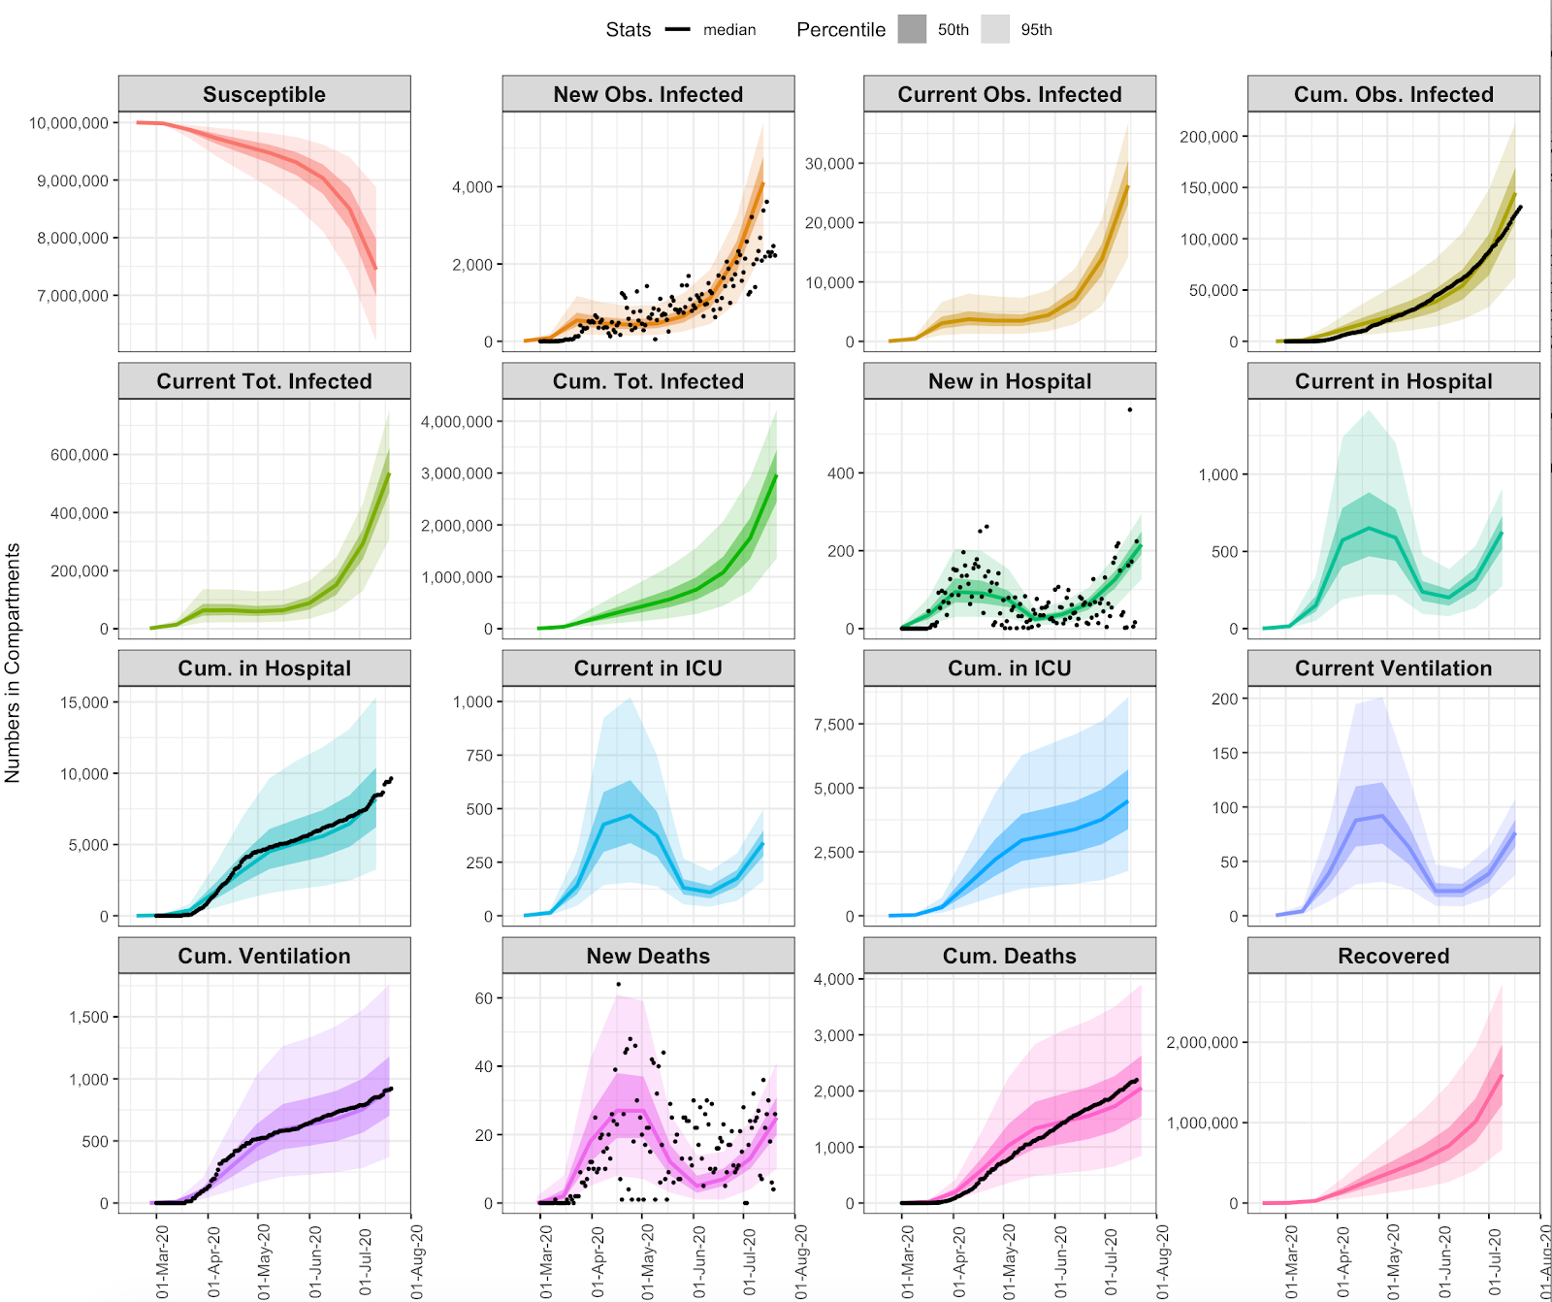
## SCENARIO 6: OBSERVED TREND Rt
## SCENARIO 7: OBSERVED TREND Rt + SHIELD SPECIFIC POPULATIONS

Slide 23
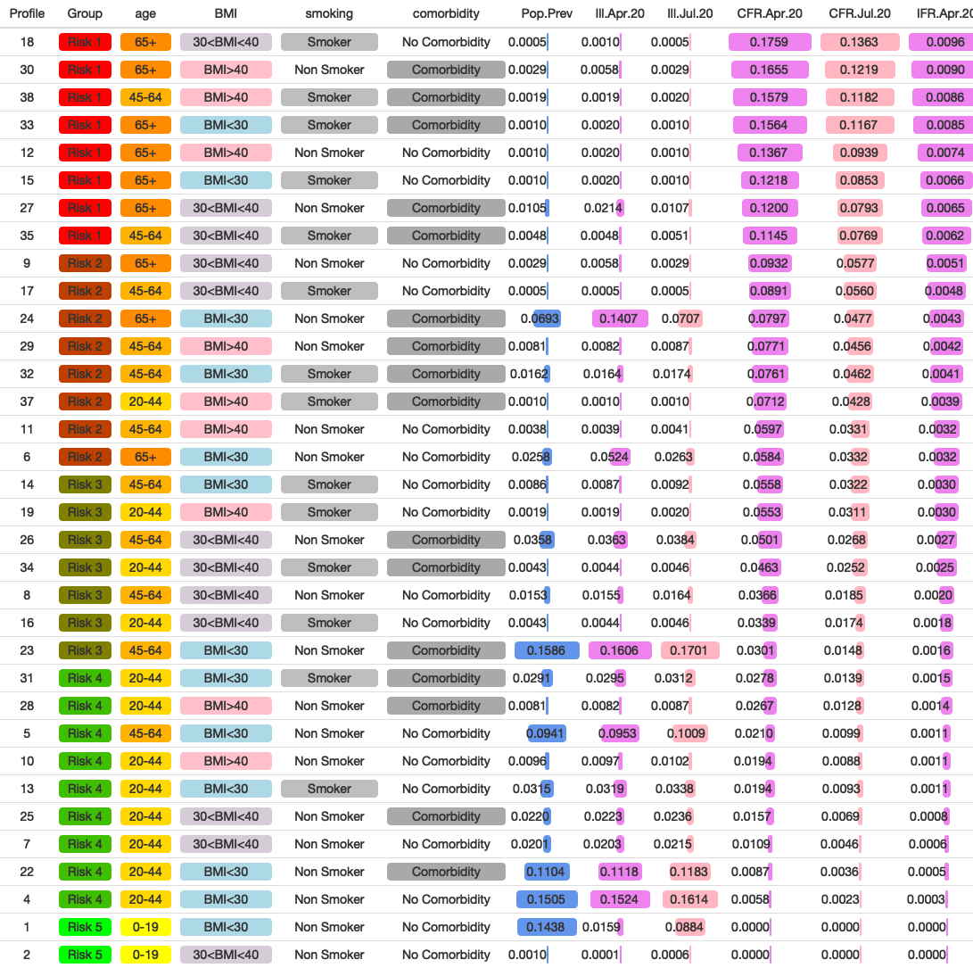
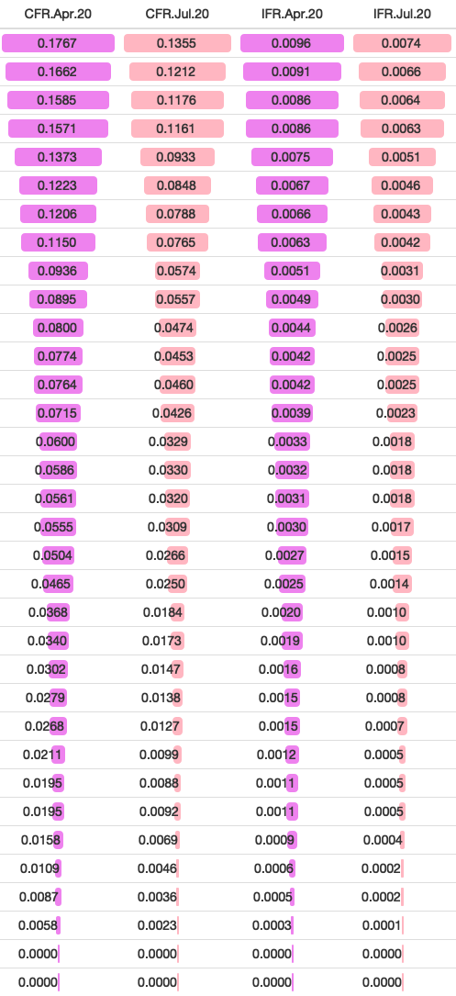

Slide 24
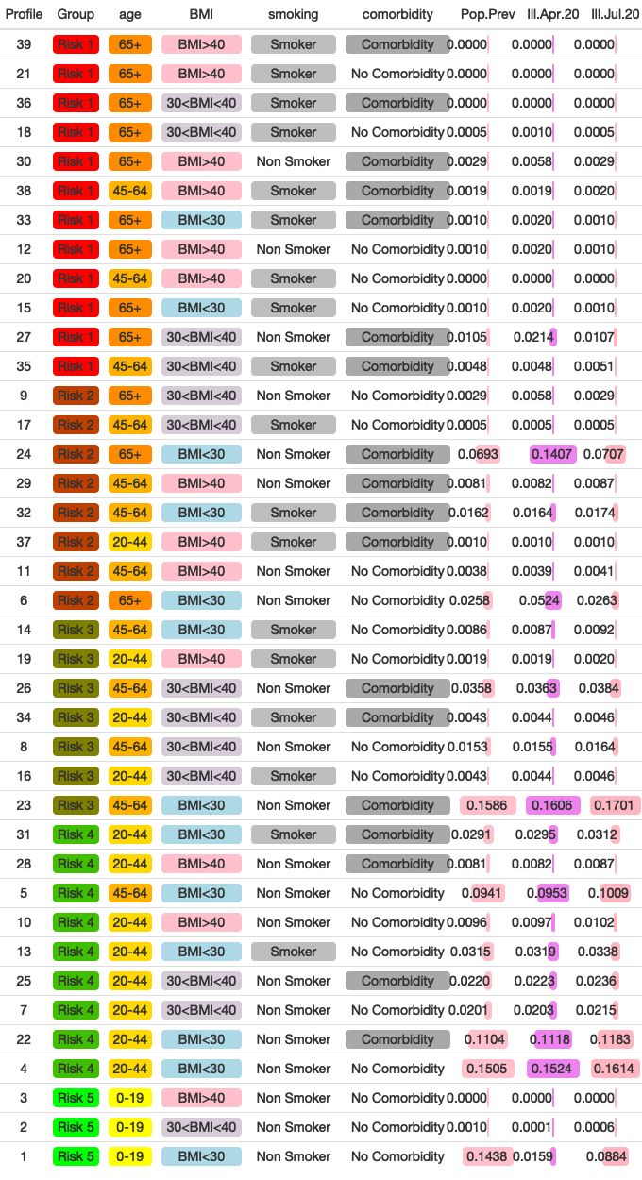
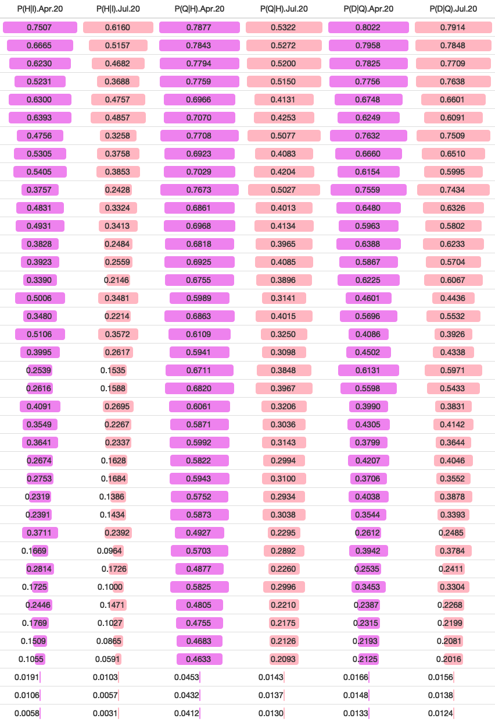

Slide 26
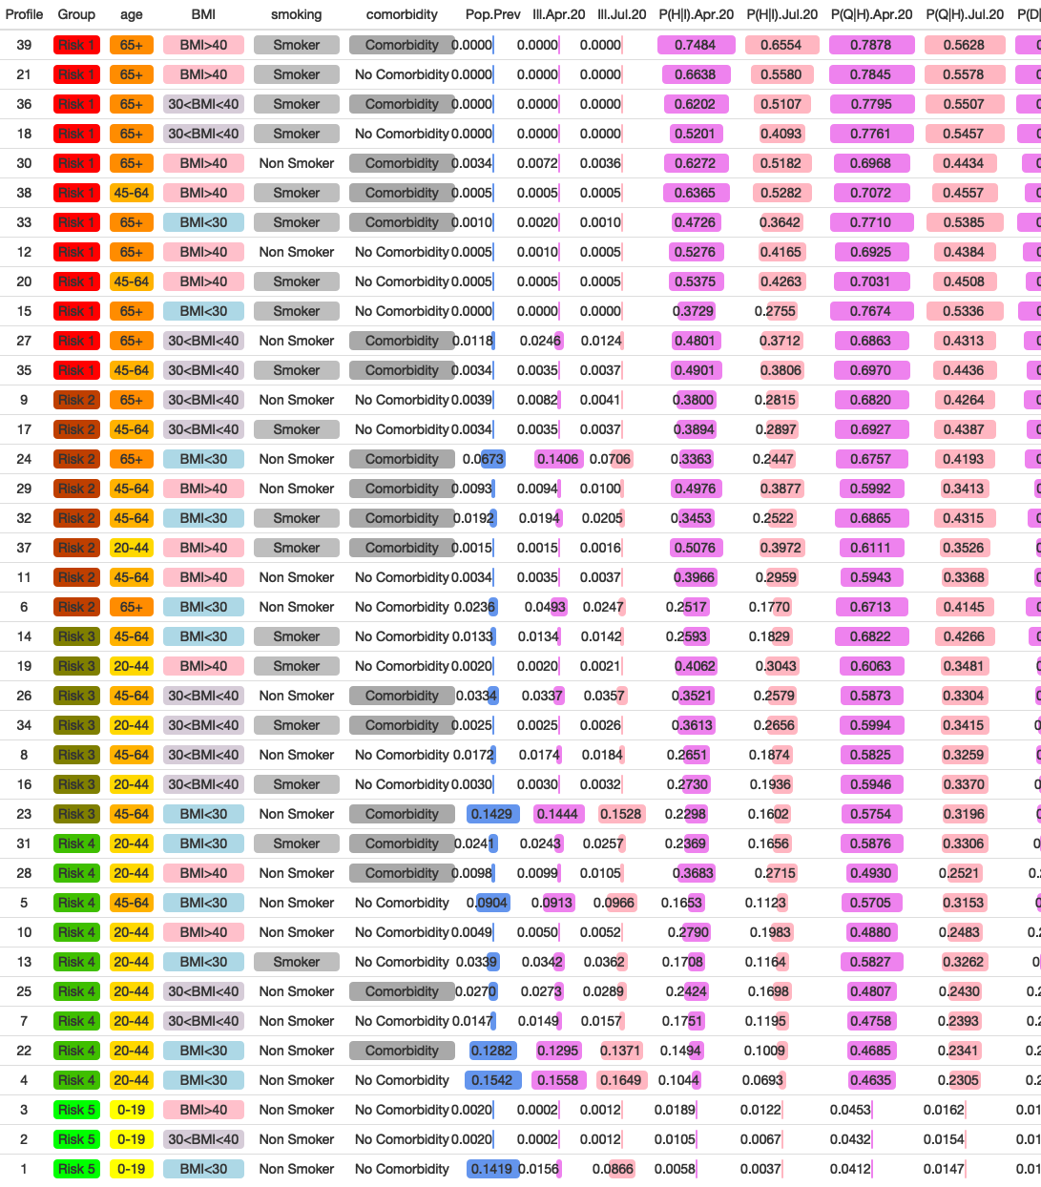
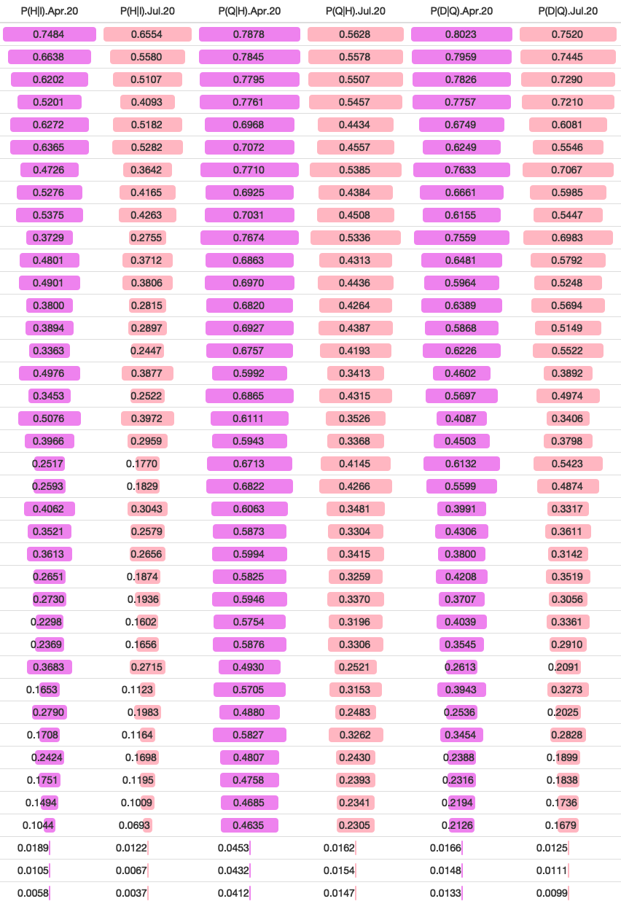
ALL TOGETHER “2”

Slide 27
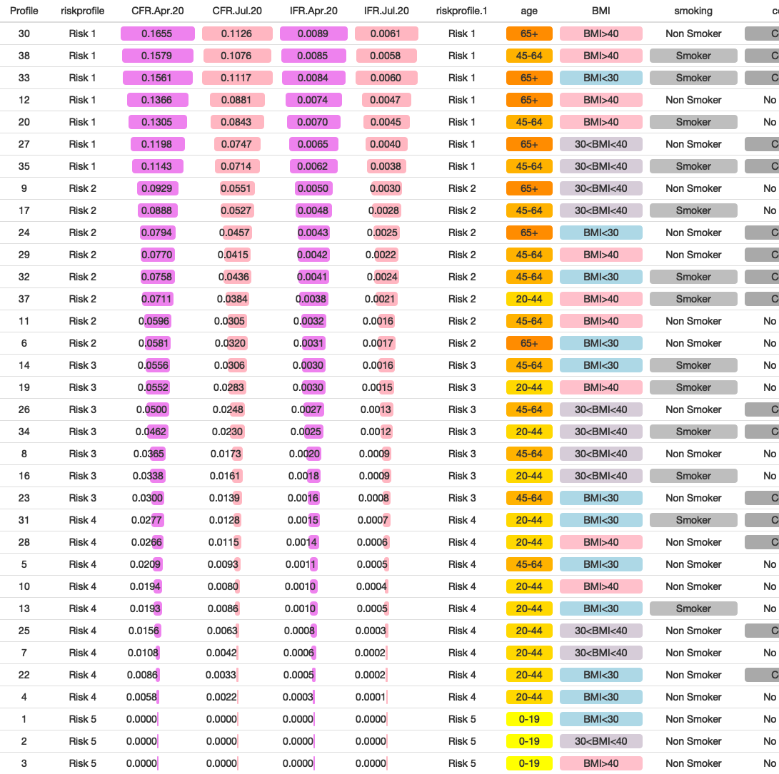
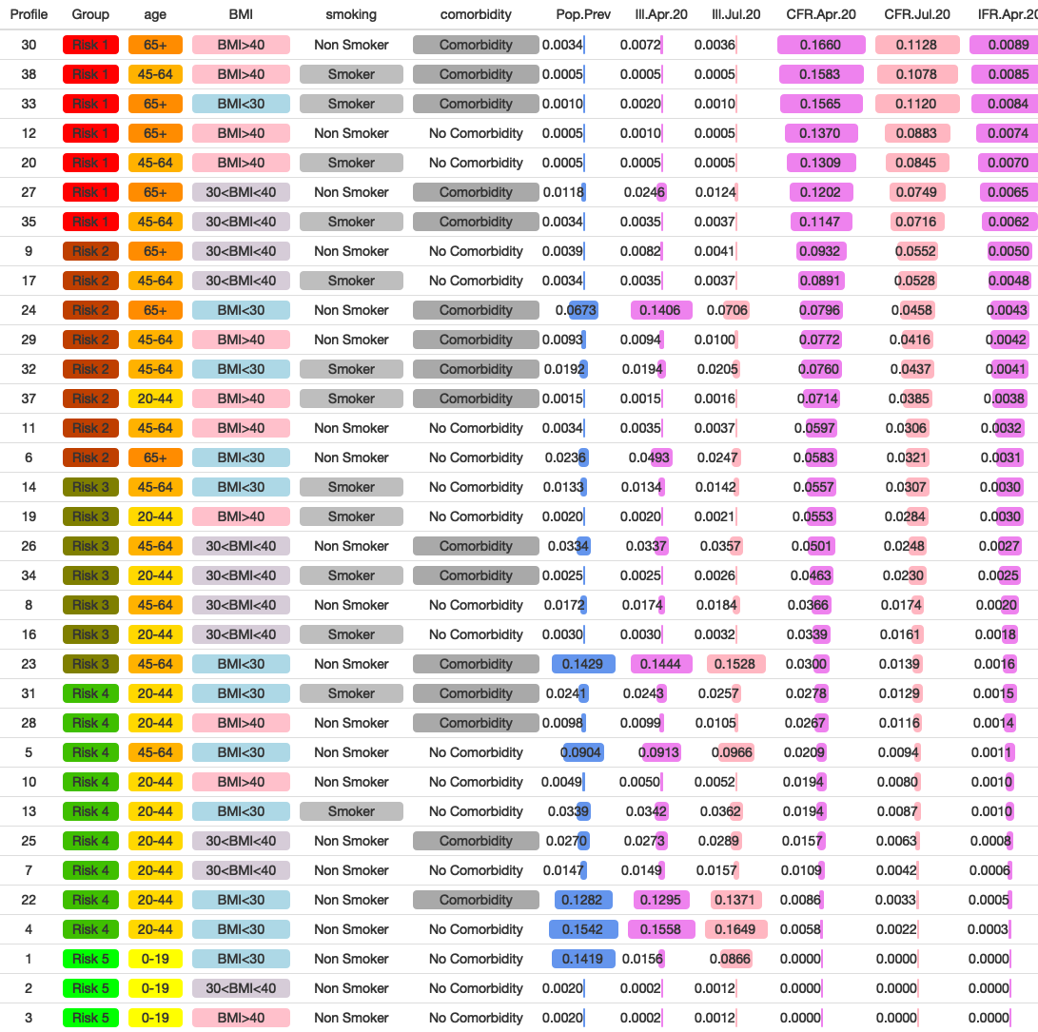
ALL TOGETHER “2”

Slide 28
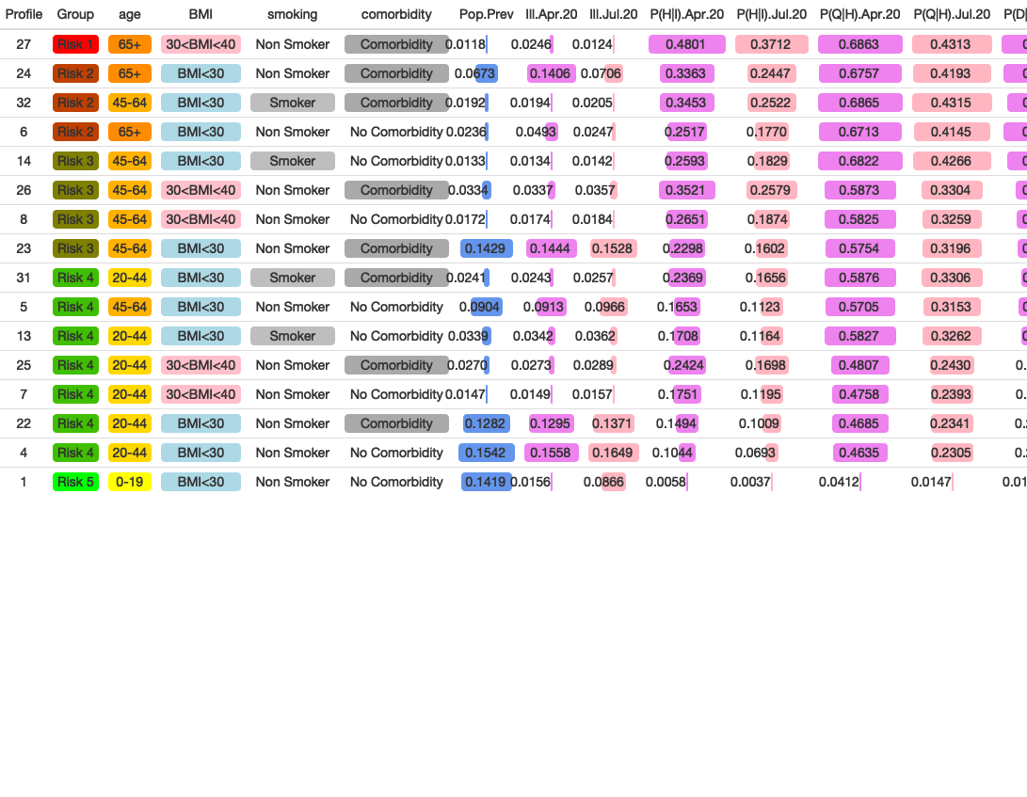
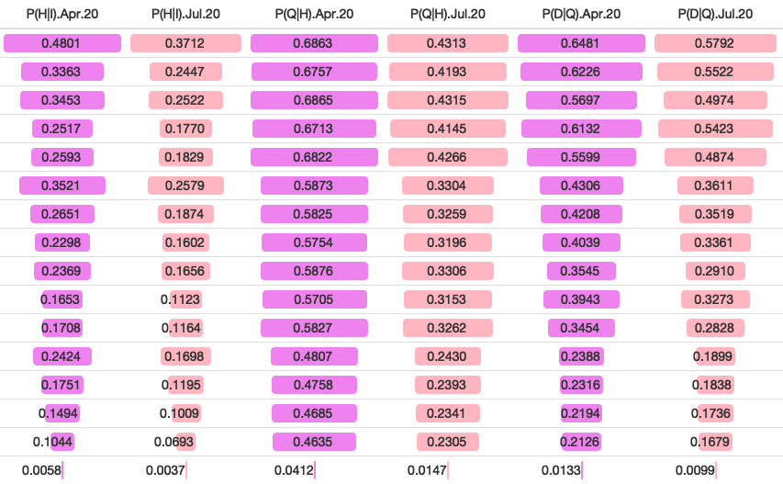
WITH PROFILE 27

Slide 29
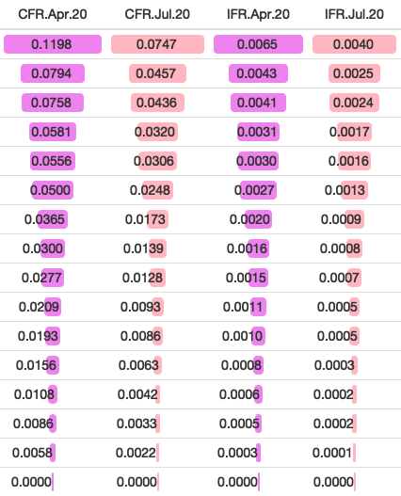
WITH PROFILE 27

Slide 31
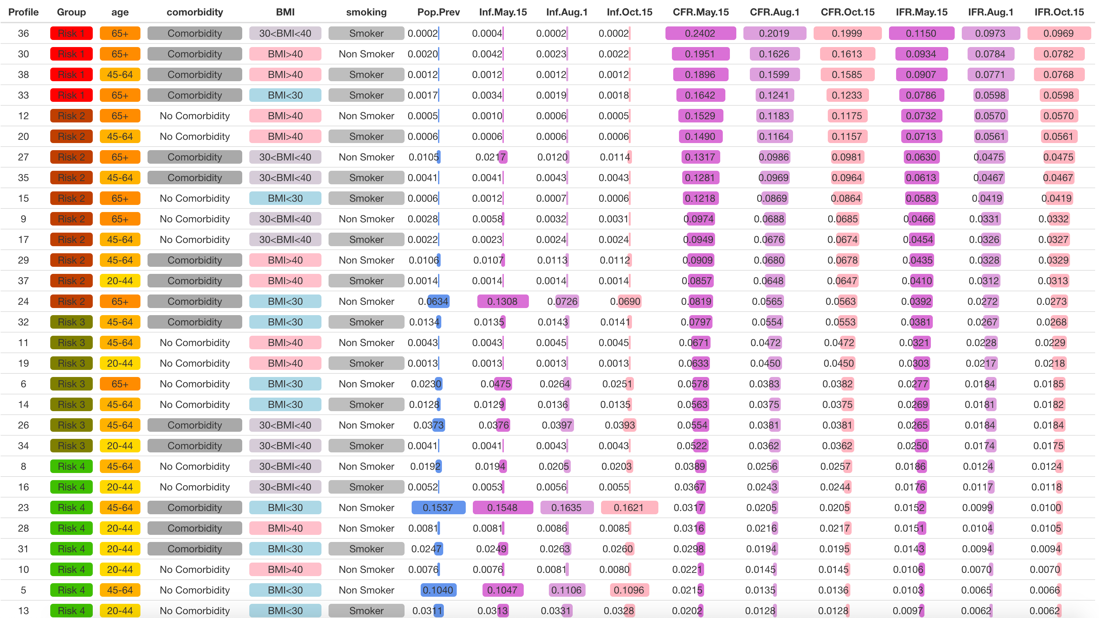
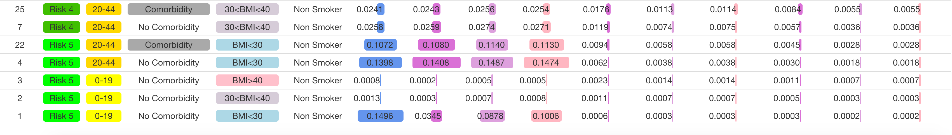

Slide 32
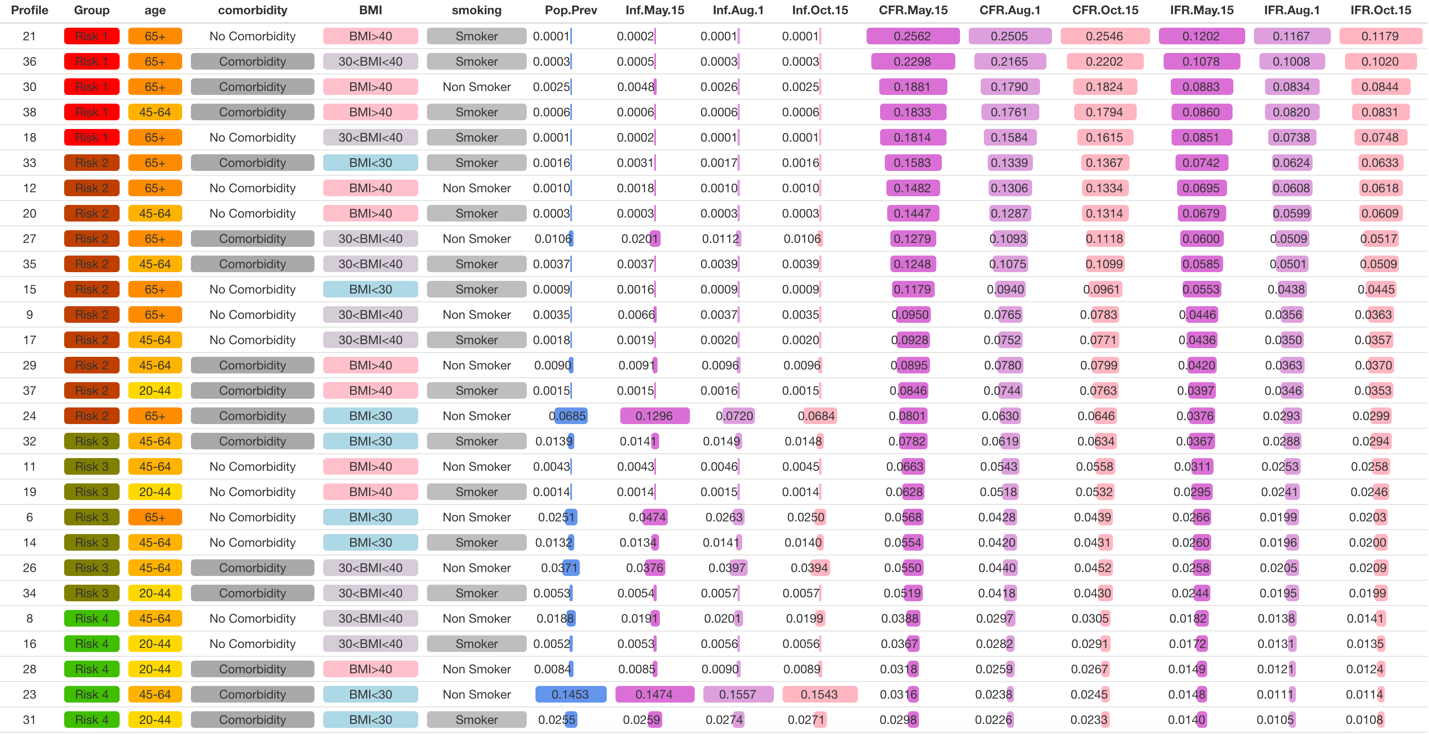
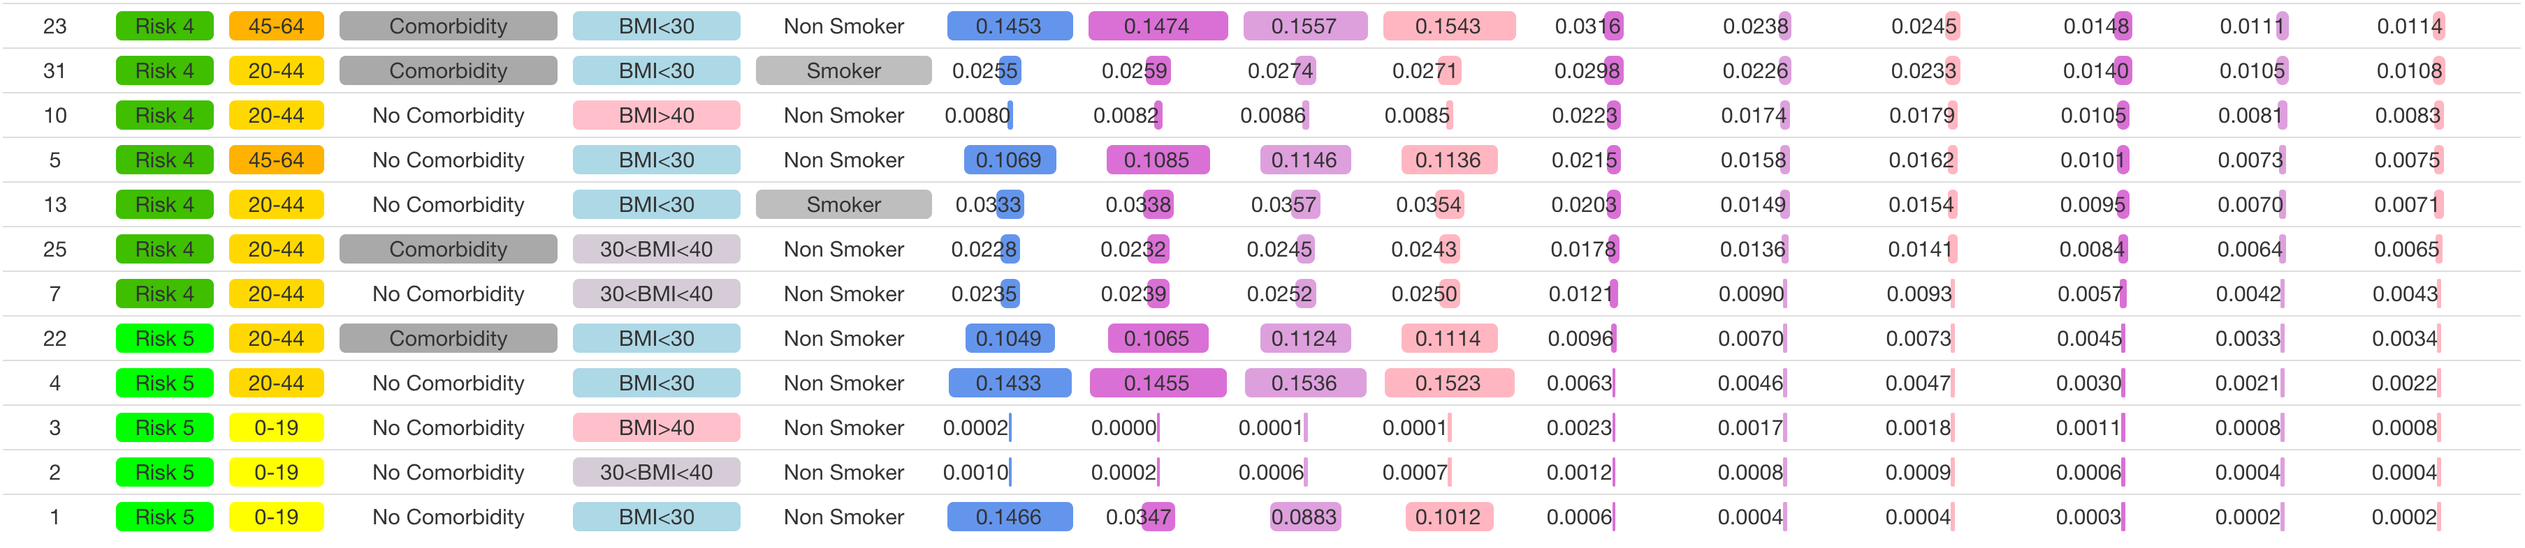

Slide 33
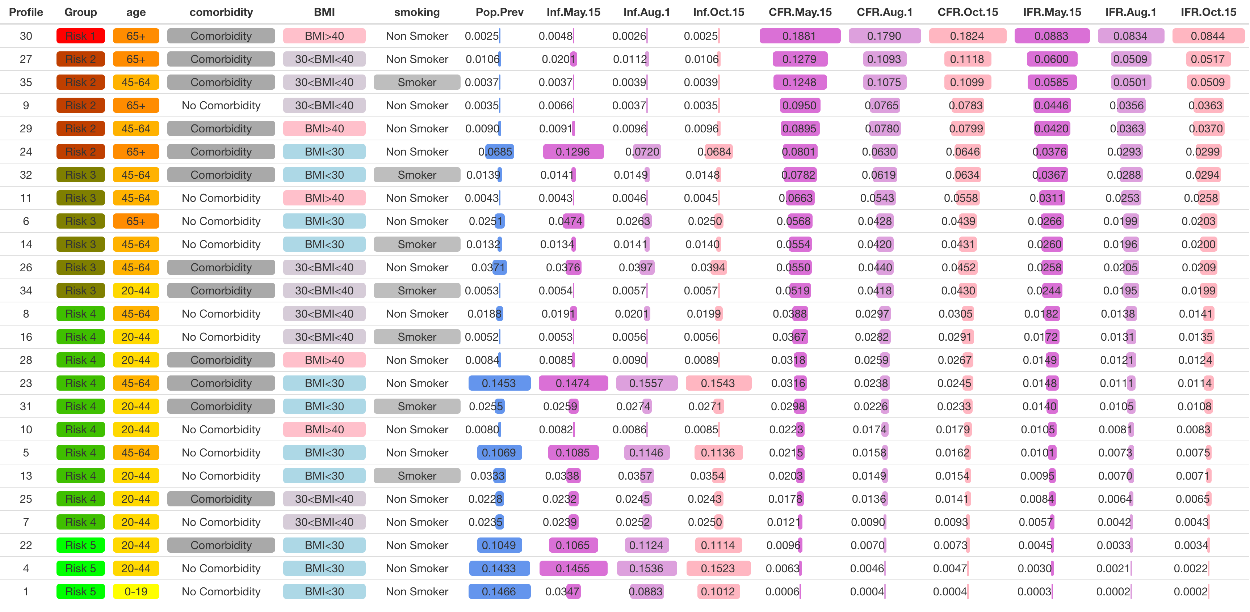

Slide 34
1
2
3
4
5
6
7
8
NPIs: None
Protect: Observed
NPIs: None
Protect: High
NPIs: Moderate
Protect: Observed
NPIs: Moderate
Protect: High
NPIs: Moderate
Protect: Moderate
NPIs: Observed
Protect: Observed
NPIs: Observed
Protect: High
NPIs: Observed
Protect: Moderate
New
Observed
Illnesses
Current
Hospitalizations
Cumulative
Deaths

Slide 35
1
2
3
4
5
6
7
8
NPIs: None
Protect: Observed
NPIs: None
Protect: High
NPIs: Moderate
Protect: Observed
NPIs: Moderate
Protect: High
NPIs: Moderate
Protect: Moderate
NPIs: Observed
Protect: Observed
NPIs: Observed
Protect: High
NPIs: Observed
Protect: Moderate
New
Observed
Illnesses
Current
Hospitalizations
Cumulative
Deaths

Slide 36
Modifications
Stage 1
Stage 2
Stage 3
19-Mar
8-May
12-Jun
28-Jun
Notes:
Stage I (Initial shutdown): March 19 - May 7
All non-essential businesses closed, schools closed.
* The outbreak begins in Los Angeles with clear exponential spread; full County-wide policy and effort to dramatically limit healthcare overload and deaths by limiting spread. Successful in decreasing hospitalizations, critical illnesses, and deaths (with a delay).
Stage II: May 8 - June 11
Low-risk businesses, public spaces for exercise allowed to open (May 8); followed by retail stores for curbside pickup (May 13); houses of worship, political protests, offices that cannot support remote work (May 26); salons and restaurants for on-site dining (May 29)
* Hospitalizations, critical illnesses, and deaths start increasing following the increasing reopening (and subsequent increase in contact rate – see mobility data) in Stage 2
Stage III: June 12 - current
Process of further reopening: First steps open medium-risk (REF) businesses including gyms, museums, hotels (June 12), followed by high-risk (REF) establishments including salons, bars, restaurants (June 19).
* Hospitalizations and severe illnesses start increasing; modifications follow to close highest risk establishments including Bars and wineries closed (June 28); followed by indoor dining at restaurants (July 1); and gyms, indoor malls, houses of worship, non-critical offices, and salons (July 13). Illnesses continue to spread as R(t) continues to rise, or stabilize (as seen in the mobility data); hospitalizations and critical illnesses continue to rise. Notably, an increase in deaths has not begun to follow, even after 6 weeks of sustained increase in hospitalizations.
- Need to discuss R(t) specifically: and how this embodies mobility data.
- Start by describing all 3 at a high level (introducing what they are). Then describe in context of key dates. Then describe what the total prevalence rate means – may want Dave’s suggestions on this

Slide 37
Stage 1
Stage 2
Stage 3
19-Mar
8-May
12-Jun
28-Jun
Modifications
Notes:
Stage I (Initial shutdown): March 19 - May 7
All non-essential businesses closed, schools closed.
* The outbreak begins in Los Angeles with clear exponential spread; full County-wide policy and effort to dramatically limit healthcare overload and deaths by limiting spread. Successful in decreasing hospitalizations, critical illnesses, and deaths (with a delay).
Stage II: May 8 - June 11
Low-risk businesses, public spaces for exercise allowed to open (May 8); followed by retail stores for curbside pickup (May 13); houses of worship, political protests, offices that cannot support remote work (May 26); salons and restaurants for on-site dining (May 29)
* Hospitalizations, critical illnesses, and deaths start increasing following the increasing reopening (and subsequent increase in contact rate – see mobility data) in Stage 2
Stage III: June 12 - current
Process of further reopening: First steps open medium-risk (REF) businesses including gyms, museums, hotels (June 12), followed by high-risk (REF) establishments including salons, bars, restaurants (June 19).
* Hospitalizations and severe illnesses start increasing; modifications follow to close highest risk establishments including Bars and wineries closed (June 28); followed by indoor dining at restaurants (July 1); and gyms, indoor malls, houses of worship, non-critical offices, and salons (July 13). Illnesses continue to spread as R(t) continues to rise, or stabilize (as seen in the mobility data); hospitalizations and critical illnesses continue to rise. Notably, an increase in deaths has not begun to follow, even after 6 weeks of sustained increase in hospitalizations.
- Need to discuss R(t) specifically: and how this embodies mobility data.
- Start by describing all 3 at a high level (introducing what they are). Then describe in context of key dates. Then describe what the total prevalence rate means – may want Dave’s suggestions on this

Slide 38
Stage 1
Stage 2
Stage 3
19-Mar
8-May
12-Jun
28-Jun
Modifications
Notes:
Stage I (Initial shutdown): March 19 - May 7
All non-essential businesses closed, schools closed.
* The outbreak begins in Los Angeles with clear exponential spread; full County-wide policy and effort to dramatically limit healthcare overload and deaths by limiting spread. Successful in decreasing hospitalizations, critical illnesses, and deaths (with a delay).
Stage II: May 8 - June 11
Low-risk businesses, public spaces for exercise allowed to open (May 8); followed by retail stores for curbside pickup (May 13); houses of worship, political protests, offices that cannot support remote work (May 26); salons and restaurants for on-site dining (May 29)
* Hospitalizations, critical illnesses, and deaths start increasing following the increasing reopening (and subsequent increase in contact rate – see mobility data) in Stage 2
Stage III: June 12 - current
Process of further reopening: First steps open medium-risk (REF) businesses including gyms, museums, hotels (June 12), followed by high-risk (REF) establishments including salons, bars, restaurants (June 19).
* Hospitalizations and severe illnesses start increasing; modifications follow to close highest risk establishments including Bars and wineries closed (June 28); followed by indoor dining at restaurants (July 1); and gyms, indoor malls, houses of worship, non-critical offices, and salons (July 13). Illnesses continue to spread as R(t) continues to rise, or stabilize (as seen in the mobility data); hospitalizations and critical illnesses continue to rise. Notably, an increase in deaths has not begun to follow, even after 6 weeks of sustained increase in hospitalizations.
- Need to discuss R(t) specifically: and how this embodies mobility data.
- Start by describing all 3 at a high level (introducing what they are). Then describe in context of key dates. Then describe what the total prevalence rate means – may want Dave’s suggestions on this

Slide 39
Stage 1
Stage 2
Stage 3
19-Mar
8-May
12-Jun
28-Jun
Modifications
Notes:
Stage I (Initial shutdown): March 19 - May 7
All non-essential businesses closed, schools closed.
* The outbreak begins in Los Angeles with clear exponential spread; full County-wide policy and effort to dramatically limit healthcare overload and deaths by limiting spread. Successful in decreasing hospitalizations, critical illnesses, and deaths (with a delay).
Stage II: May 8 - June 11
Low-risk businesses, public spaces for exercise allowed to open (May 8); followed by retail stores for curbside pickup (May 13); houses of worship, political protests, offices that cannot support remote work (May 26); salons and restaurants for on-site dining (May 29)
* Hospitalizations, critical illnesses, and deaths start increasing following the increasing reopening (and subsequent increase in contact rate – see mobility data) in Stage 2
Stage III: June 12 - current
Process of further reopening: First steps open medium-risk (REF) businesses including gyms, museums, hotels (June 12), followed by high-risk (REF) establishments including salons, bars, restaurants (June 19).
* Hospitalizations and severe illnesses start increasing; modifications follow to close highest risk establishments including Bars and wineries closed (June 28); followed by indoor dining at restaurants (July 1); and gyms, indoor malls, houses of worship, non-critical offices, and salons (July 13). Illnesses continue to spread as R(t) continues to rise, or stabilize (as seen in the mobility data); hospitalizations and critical illnesses continue to rise. Notably, an increase in deaths has not begun to follow, even after 6 weeks of sustained increase in hospitalizations.
- Need to discuss R(t) specifically: and how this embodies mobility data.
- Start by describing all 3 at a high level (introducing what they are). Then describe in context of key dates. Then describe what the total prevalence rate means – may want Dave’s suggestions on this

Slide 40
Stage 1
Stage 2
Stage 3
19-Mar
8-May
12-Jun
28-Jun
Modifications
Notes:
Stage I (Initial shutdown): March 19 - May 7
All non-essential businesses closed, schools closed.
* The outbreak begins in Los Angeles with clear exponential spread; full County-wide policy and effort to dramatically limit healthcare overload and deaths by limiting spread. Successful in decreasing hospitalizations, critical illnesses, and deaths (with a delay).
Stage II: May 8 - June 11
Low-risk businesses, public spaces for exercise allowed to open (May 8); followed by retail stores for curbside pickup (May 13); houses of worship, political protests, offices that cannot support remote work (May 26); salons and restaurants for on-site dining (May 29)
* Hospitalizations, critical illnesses, and deaths start increasing following the increasing reopening (and subsequent increase in contact rate – see mobility data) in Stage 2
Stage III: June 12 - current
Process of further reopening: First steps open medium-risk (REF) businesses including gyms, museums, hotels (June 12), followed by high-risk (REF) establishments including salons, bars, restaurants (June 19).
* Hospitalizations and severe illnesses start increasing; modifications follow to close highest risk establishments including Bars and wineries closed (June 28); followed by indoor dining at restaurants (July 1); and gyms, indoor malls, houses of worship, non-critical offices, and salons (July 13). Illnesses continue to spread as R(t) continues to rise, or stabilize (as seen in the mobility data); hospitalizations and critical illnesses continue to rise. Notably, an increase in deaths has not begun to follow, even after 6 weeks of sustained increase in hospitalizations.
- Need to discuss R(t) specifically: and how this embodies mobility data.
- Start by describing all 3 at a high level (introducing what they are). Then describe in context of key dates. Then describe what the total prevalence rate means – may want Dave’s suggestions on this

Slide 41
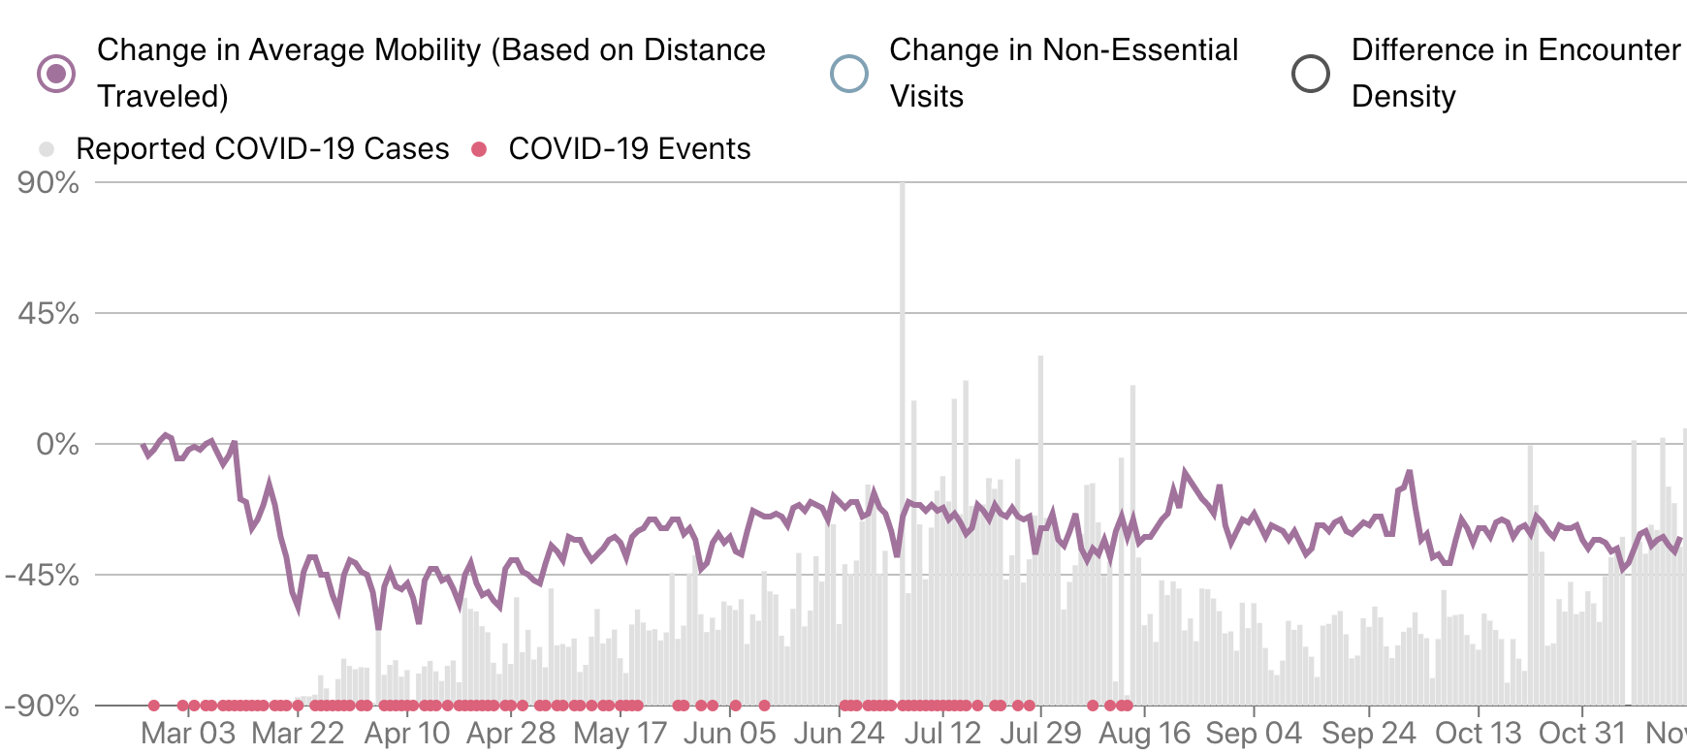
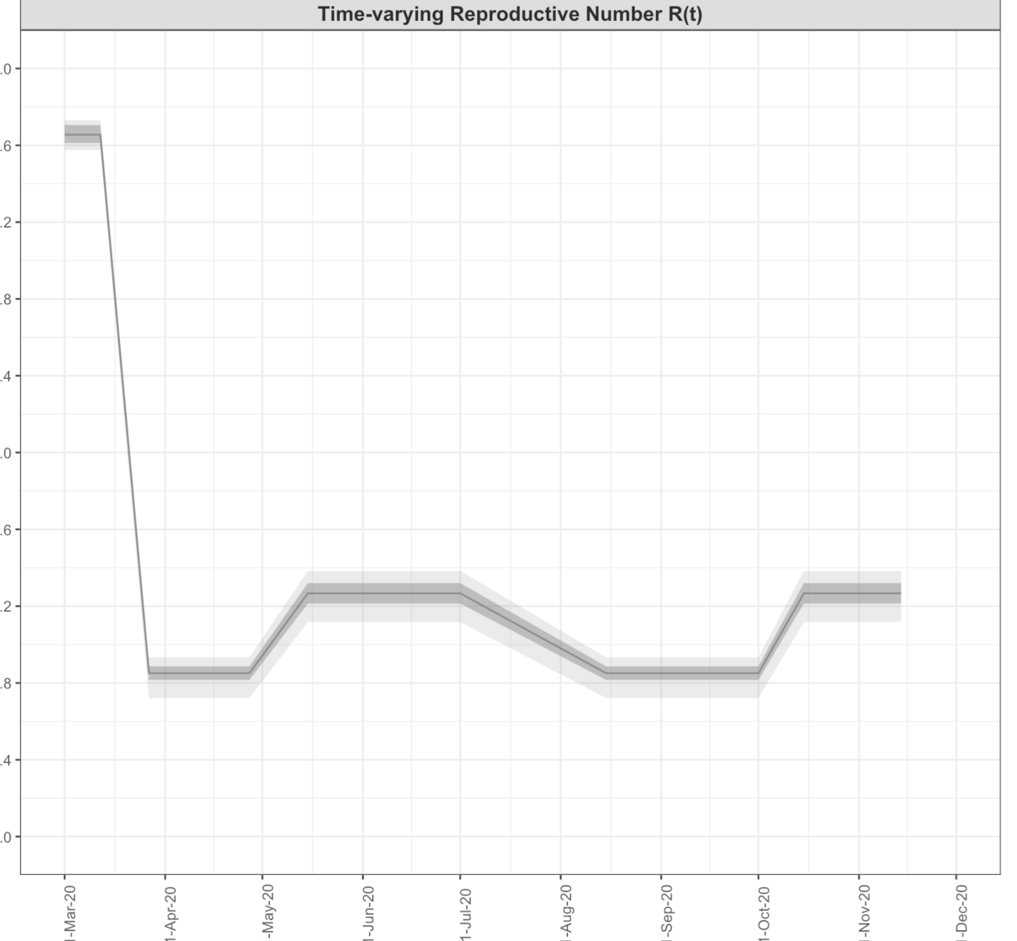
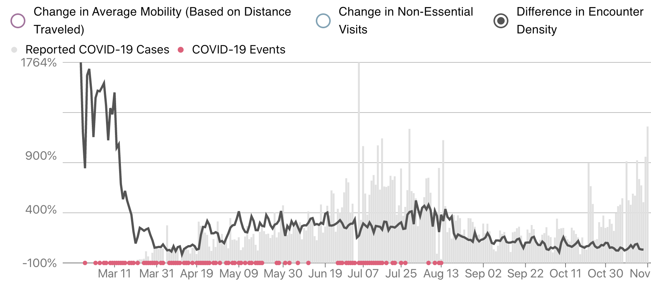

Slide 42
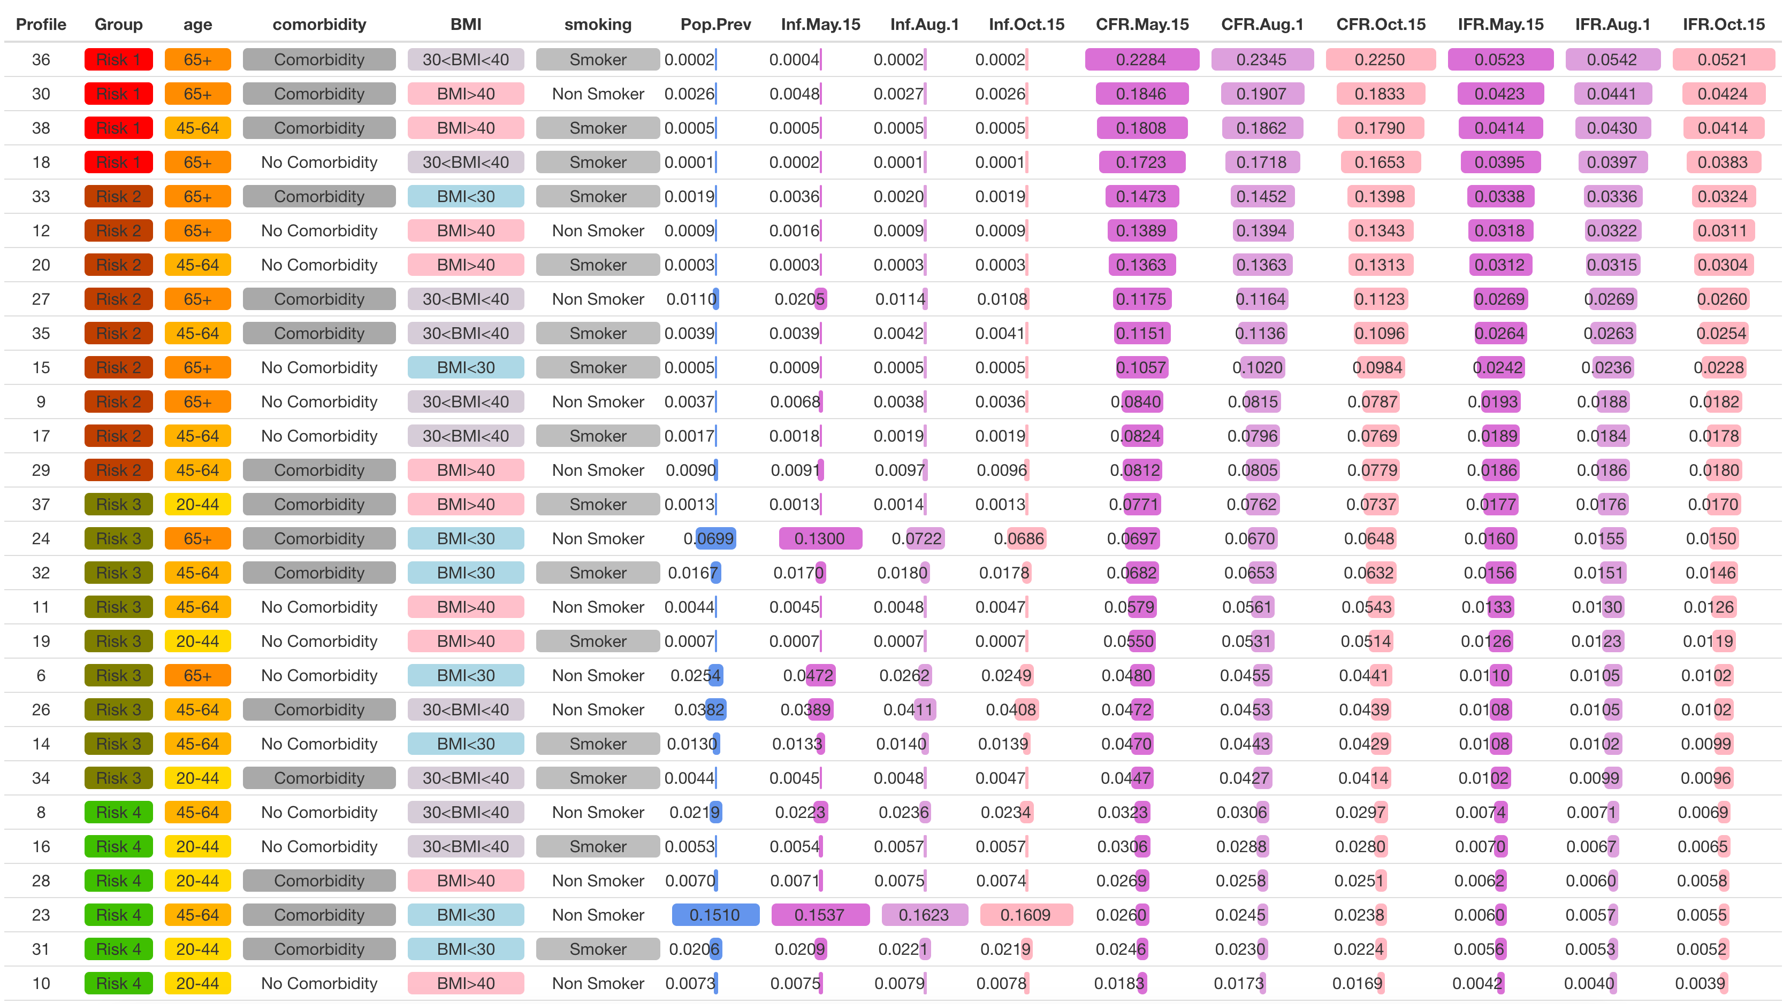
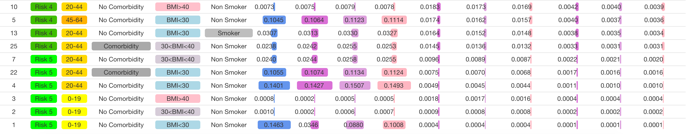

Slide 43
